Slide 1
BODY MECHANICS

Slide 2
Introduction
Body Mechanics refers to the way we move during daily activities.
It involves the coordination and alignment of the body, especially while moving, lifting, sitting, standing, and sleeping or bending.
Understanding good body mechanics plays a pivotal role in avoiding injury and maintaining a healthy posture.

Slide 3
What is Body Mechanics and its Relevance in Anatomy
Your anatomy forms the foundation for your body mechanics. Each bone, joint, and muscle has a designated role to play in facilitating movement.
The science of body mechanics takes this intricate anatomy into account, and helps you understand how to align and move your body to maximise efficiency and prevent injuries.

Slide 4
Body mechanics in medical field as a fundamental
This field requires repositioning and lifting of patients.
Good body mechanics are paramount to both their safety and that of their patients.
Negligence may lead to strain, sprains, and more severe injuries.

Slide 5
Importance of Body Mechanics
Understanding and practising good body mechanics is not an option, but a necessity.
A significant portion of work involves physically taxing tasks, such as lifting, transferring, and repositioning patients.

Slide 6
Repositioning involves the movement of a patient with the aim to rectify the alignment or positioning in order to improve comfort and prevent pressure injuries.
One cannot undermine the importance of proper body mechanics skills in preventing musculoskeletal injuries and an occupational hazard for healthcare workers.

Slide 7
Good Body Mechanics | Benefits
Proper alignment | Reduces strain on joints and muscles
Correct lifting techniques | Prevents back injuries
Effective transferral methods | Improves patient safety

Slide 8
Essential prerequisites for Good Body Mechanics
Body mechanics requires both knowledge and skill. Being aware of the principles isn't enough; it's equally crucial to have the ability to apply this knowledge effectively in real situations.
Understanding of body anatomy and physiology: Knowing how different parts of your body work together can help you make more informed decisions about movements and postures.
Awareness of the center of gravity: Your center of gravity affects your balance. Maintaining it over your base of support can greatly aid in preventing falls and enhancing stability.
Regular practice and training: Like any other skill, achieving good body mechanics requires regular practice and training.

Slide 9
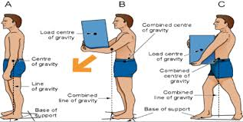

Slide 10
Principles for good body mechanics.
These principles provide a structured approach and guideline towards achieving safer and efficient handling - be it self-care or patient care.

Slide 11
Maintain alignment:
Alignment refers to how the head, shoulders, spine, hips, knees and ankles relate and line up with each other.
Keeping your body parts aligned can help distribute the weight of your body or the object you're lifting evenly.
Proper alignment of the body puts less stress on the spine and helps you have good posture.

Slide 12
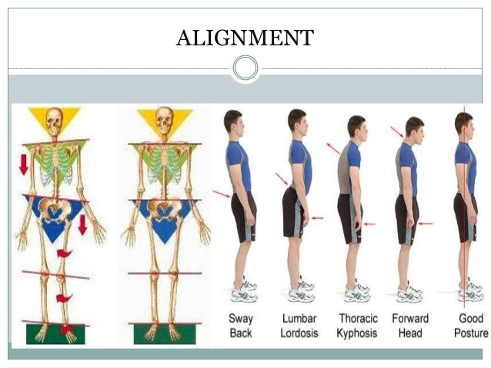

Slide 13
Use the strongest muscles: Major muscles in your legs and arms are stronger and more durable than small muscles in your back. Therefore, using them can reduce the risk of injuries.
Don’t twist: If you need to turn, pivot on your foot instead of twisting your back. This reduces pressure on your spinal discs.

Slide 14
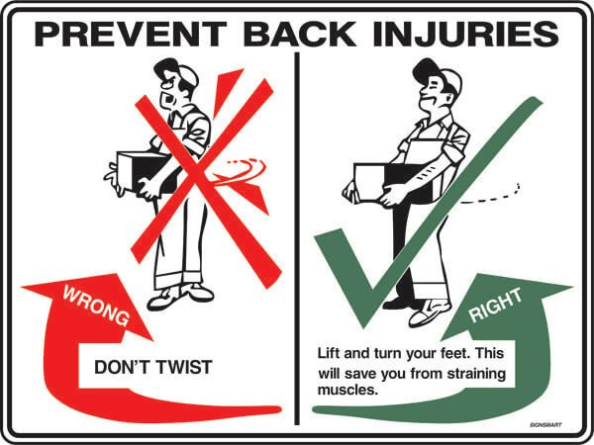

Slide 15
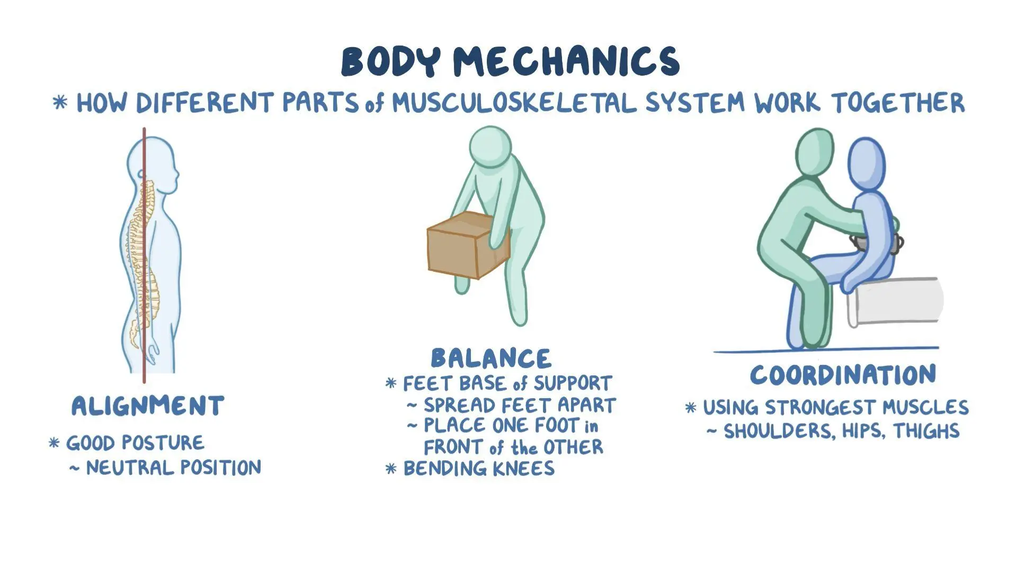

Slide 16
Comparing Good and Poor Body Mechanics
Good Body Mechanics | Poor Body Mechanics
Optimum use of body’s strength | Unnecessary strain on muscles
Reduced risk of injury | Increased risk of injury
Patient safety and comfort | Increased risk of patient discomfort and harm

Slide 17
Guidelines for Proper Body Mechanics
Figure out how much help a patient needs to move. Some patients can support some of their weight, while others cannot move at all. If a patient cannot move on their own, the health care worker should ask others for help or use special equipment to safely move the patient.
Make sure the patient is at a comfortable height when helping them. For most patients, this means adjusting them to waist level. This helps avoid back pain from bending over while assisting a patient in bed.

Slide 18
Avoid leaning or stretching when helping patients. Keep the patient close to your body when moving them, whether in bed, a chair, or to a new place.
Stand with feet about shoulder-width apart, with one foot slightly in front of the other, before moving a patient. This provides better balance and helps distribute weight evenly. The patient's weight should also be balanced. Keep your lower back straight to avoid injury.
Use leg muscles instead of back muscles when lifting patients. Bending the knees and following other steps helps use the strong leg muscles and avoid back pain.

Slide 19
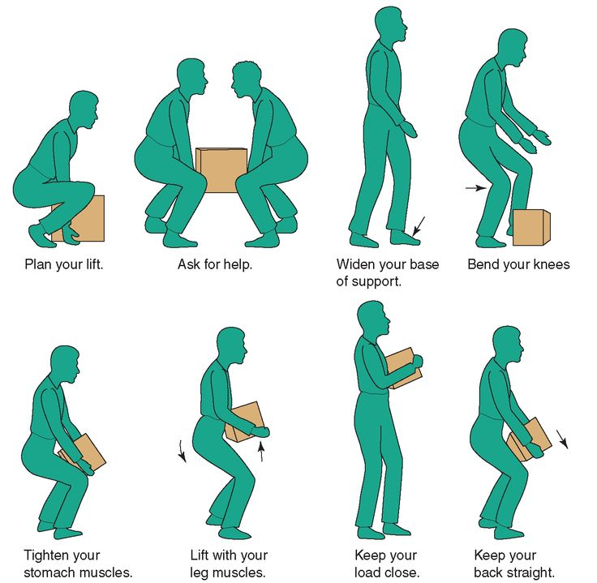

Slide 20
MOVING AND LIFTING

Slide 21
Moving and lifting of the patients means shift or transfer the patient from one place to another place with the use of different types of devices.
For example wheel chair, stretcher, wheel bed

Slide 22
Moving and lifting patients is an essential part of caregiving, but it requires careful attention to ensure safety and comfort for both the patient and the caregiver.
By following general instructions and using proper techniques, you can minimize the risk of injury and provide the best possible care for your patients. Always remember to prioritize safety, communication, and teamwork in all patient handling tasks.

Slide 23
Indications
Pre-operative/ post operative
Anaemic
Old-age patients
Critically ill patients
Semi-conscious, conscious and coma patients

Slide 24
Rules for lifting
Position your feet properly.
Use your legs.
Never turn or twist.
Do not compensate when lifting with one hand.
Keep weight as close as possible to your body.
Use a stair chair when carrying patient on stairs whenever possible.

Slide 25
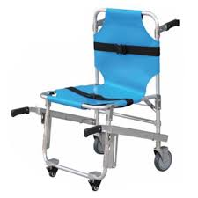
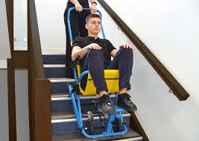

Slide 26
Once a patient is stable and able to move around, begin the steps for developing a moving plan.
The goal is to let patient become as independent as possible.
Grips and holds for lifting.
The finger grip.
The double wrist grip.
The double forearm hold.

Slide 27
General Instructions for Moving and Lifting Patients
Caring for patients often involves assisting them with movement and lifting, whether it’s helping them change positions in bed or transferring them between surfaces.
Proper technique is essential to ensure both the safety of the patient and the caregiver.

Slide 28
Assess the Situation
Before attempting to move or lift a patient, assess the situation carefully. Determine if you need assistance and what equipment might be necessary for the task. Always communicate with the patient to ensure they are comfortable and understand what is happening.
Communicate with the Patient
Always inform the patient about what you are going to do before moving or lifting them. Explain the process, and ask for their cooperation. Make sure to listen to any concerns or feedback they may have.

Slide 29
Use Proper Body Mechanics
Using proper body mechanics is crucial to prevent injuries to yourself and the patient. Here are some tips:
Bend at the knees, not the waist, when lifting.
Keep your back straight and use your leg muscles to lift.
Avoid twisting your body while lifting; instead, pivot your feet.
Keep the patient close to your body to minimize strain.

Slide 30
Use Assistive Devices
Whenever possible, use assistive devices such as transfer belts, slide sheets, or mechanical lifts to help move and lift patients safely. These tools can reduce the risk of injury and make the process more comfortable for the patient.
Teamwork
If the patient is heavy or requires complex movement, do not hesitate to ask for help. Working as a team can make lifting and moving patients easier and safer for everyone involved.

Slide 31
Plan Ahead
Before moving or lifting a patient, plan the process carefully. Make sure the path is clear of obstacles, and check that all equipment is in working order. Having a plan in place can help prevent accidents and ensure a smooth transfer.
Monitor the Patient
While moving or lifting a patient, pay attention to their comfort and well-being. If they experience any pain or discomfort, stop immediately and reassess the situation. Always check for any signs of skin breakdown or other injuries after moving the patient.

Slide 32
Document the Process
After moving or lifting a patient, document the process, including any equipment used, the patient’s condition before and after the transfer, and any observations or concerns. This information can be valuable for on-going care and future reference.

