Slide 2
NSC 100/111: BASIC NURSING SKILLS
OVERVIEW 1.
CLIENT INTERACTIONS

Slide 3


NSC 100/111: Basics of Nursing skills
CLIENT INTERACTIONS

Slide 4
CLIENT INTERACTIONS
Defn -Client interaction, also known as customer interaction;
  The way a business interacts with its customers.
  Responding to customer inquiries, resolving issues, and providing personalized service communications and engagements that occur between a caregiver and a client/customer.
  Typically many instances of this throughout the customer journey.
  May involve public relation representatives in corporations (front office)

Slide 5
Best practices
Personalize interactions: Make customers feel important by offering personalized experiences.
Be responsive: Respond quickly and effectively to customer issues.
Show empathy: Connect with customers and demonstrate understanding.
Collect feedback: Gather customer feedback at every touchpoint to identify pain points and improve customer satisfaction.
Segment customers: Analyze customer data to create targeted communication that addresses specific needs and preferences.
Train staff: Use call recordings and chat transcripts to train customer service representatives on best practices

Slide 6
Skills for client interaction
Active listening: Understand the customer's needs and concerns
Effective communication: Be clear and concise when conveying information
Problem-solving: Address issues and find appropriate solutions
Patience: Maintain a positive and respectful attitude

Slide 7
Key professional attributes
Courtesy - showing of politeness in one's attitude and behaviour towards others
Privacy - the right to be free from intrusion and to control who has access to information about you.
Respect - feeling of deep admiration for someone or something elicited by their abilities, qualities, or achievements (Being)
Confidentiality - the state of keeping or being kept secret or private.

Slide 9
NSC 100/111: BASIC NURSING SKILLS
OVERVIEW 2.
Health, Wellness,
and Illness

Slide 10
Learning Outcomes
Identify influences on clients’ definitions of health, wellness, and well-being.
Describe five components of wellness.
Compare the various models of health.
Identify variables affecting health status, beliefs, and practices.
Describe factors affecting health care adherence.

Slide 11
Learning Outcomes (cont'd)
Differentiate illness from disease and acute illness from chronic illness.
Describe the effects of illness on individuals’ and family members’ roles and functions.

Slide 12
Health, Wellness, Well-being
Many definitions and interpretations
Be familiar with common aspects of concepts
Consider how to individualize with specific clients

Slide 13
Health
Presence or absence of disease
Complete physical, mental, social well-being
Ability to maintain normal roles
Developmental and behavioral potential is realized to fullest extent possible
Striving toward optimal functioning
Individual perception

Slide 14
Wellness
Wellness - state of well-being
5 basic components:
  Self-responsibility
  An ultimate goal
  A dynamic, growing process
  Daily decision-making (nutrition, stress management, physical fitness, preventive health care, and emotional health)
  Whole being of the individual

Slide 15
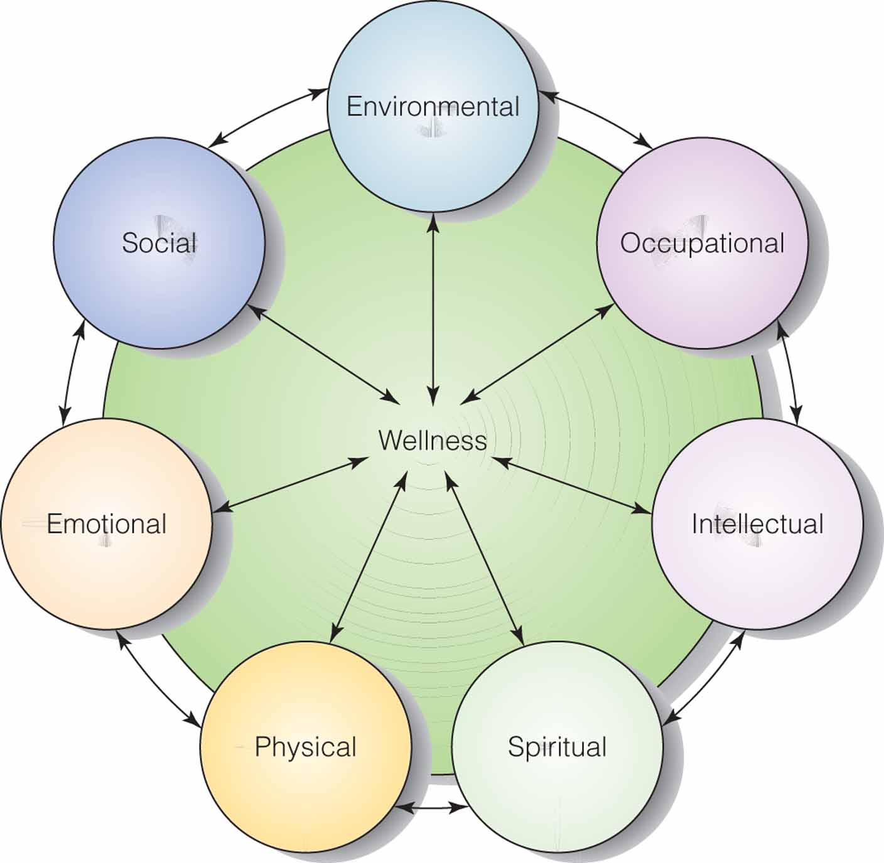
Figure 17-2 The seven components of wellness.From Wellness: Concepts and Applications, 7th ed. (p. 4), by D. J. Anspaugh, M. H. Hamrick, and F. D. Rosato, 2009, New York, NY: McGraw-Hill. Reprinted with permission.
Notes:
15

Slide 16
Physical Components of Wellness
Carry out daily tasks
Achieve fitness
Maintain nutrition
Avoid abusing substances
Practice positive lifestyle habits

Slide 17
Social Components of Wellness
Interact successfully
Develop and maintain intimacy
Develop respect and tolerance for others

Slide 18
Emotional Components of Wellness
Ability to manage stress
Ability to express emotion

Slide 19
Intellectual Components of Wellness
Ability to learn
Ability to use information effectively
Striving for continued growth
Learning to deal with new challenges

Slide 20
Spiritual Components of Wellness
Belief in some force that gives life meaning and purpose
Person’s own morals, values, and ethics

Slide 21
Occupational Component of Wellness
Ability to achieve balance between work and leisure

Slide 22
Environmental Components of Wellness
Ability to promote health measure that improves
  Standard of living
  Quality of life
Influences such as food, water, and air

Slide 23
Well-being
Subjective perception of vitality and feeling well
Can be described objectively, experienced, measured
Can be plotted on a continuum

Slide 24
Assignment 1.
Models of Health
Clinical model
Role performance model
Adaptive model
Eudemonistic model
Agent-host-environment model
Health-illness continuum

Slide 25
Agent-Host-Environment Model
Each factor constantly interacts with the others
When in balance, health is maintained
When not in balance, disease occurs

Slide 26
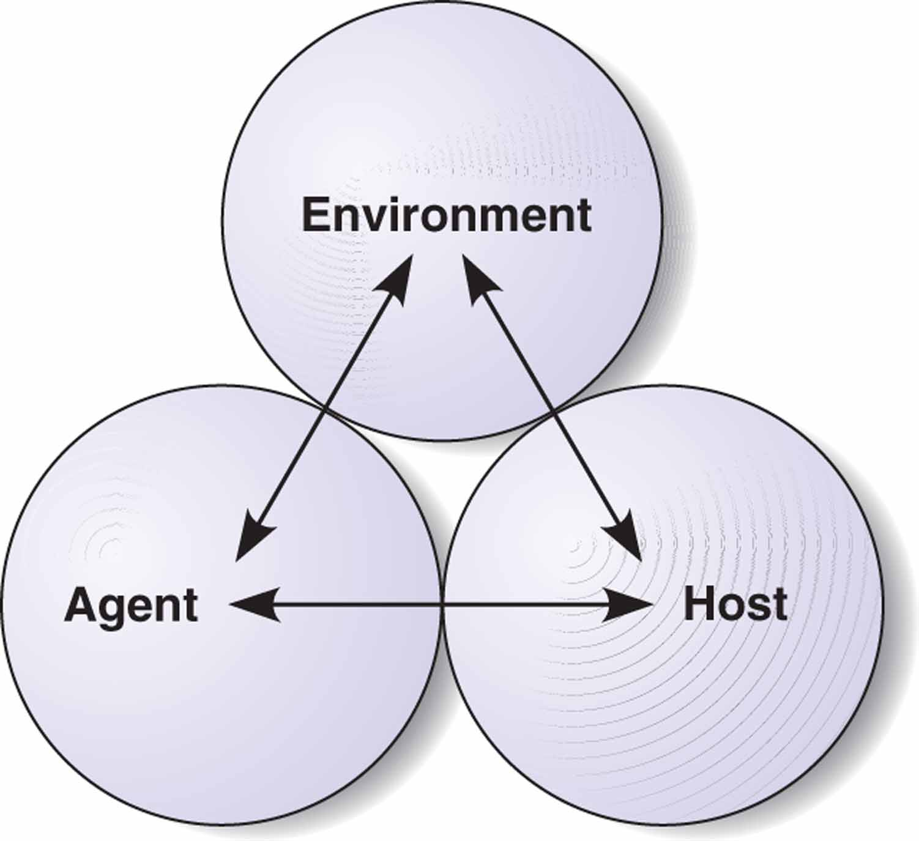
Figure 17-3 The agent–host–environment triangle.
Notes:
26

Slide 27
Health-Illness Continuum
Measures person’s perceived level of wellness
Health and illness/disease opposite ends of a health continuum
Move back and forth within this continuum day by day
How people perceive themselves and how others see them affects placement on the continuum

Slide 28
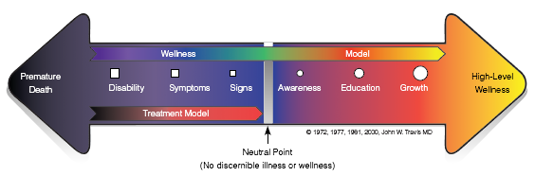
Figure 17-5 A, Illness-Wellness Continuum. From Wellness Workbook: How to Achieve Enduring Health and Vitality, 3rd ed., by J. W. Travis and R. S. Ryan, 2004, Berkeley, CA: Celestial Arts. Retrieved from http://www.thewellspring.com/wellspring/introduction-to-wellness/357/key-concept-1-the-illnesswellness-continuum.cfm

Slide 29
ASSIGNMENT 2.
Variables Influencing Health Status, Beliefs, and Practices
Internal variables
External variables

Slide 30
Health Care Adherence
Client motivation
Degree of lifestyle change
Perceived severity of health care problem
Value placed on reducing threat of illness
Ability to understand and perform specific behaviors
Degree of inconvenience of illness itself or of health regimens

Slide 31
Health Care Adherence (cont'd)
Beliefs that prescribed therapy or regimen will or will not help
Complexity, side effects, and duration of proposed therapy
Cultural heritage, beliefs, or practices that support or conflict with regimen

Slide 32
Health Care Adherence (cont'd)
Degree of satisfaction and quality and type of relationship with health care providers
Overall cost of therapy

Slide 33
Illness
A highly personal state
Person’s physical, emotional, intellectual, social, developmental, or spiritual functioning is diminished
Not synonymous with disease
May or may not be related to disease
Only person can say he or she is ill

Slide 34
Disease
Alteration in body function
Reduction of capacities or shortening of normal life span
Causation of disease is called etiology

Slide 35
Acute Illness
Characterized by symptoms of relatively short duration
Symptoms appear abruptly, subside quickly
May or may not require intervention by health care professionals
Most people return to normal level of wellness

Slide 36
Chronic Illness
Usually slow onset and lasts for 6 months or longer
Often has periods of remission (symptoms disappear) and exacerbation (symptoms reappear)
Care includes promoting independence, sense of control, and wellness
Client must learn how to live with physical limitations and discomfort

Slide 37
Effects of Illness
Impact on the client
  Behavioral and emotional changes
  Self-concept and body image changes
  Lifestyle changes
Impact on family depends on:
  Which family member is ill
  Seriousness and length of illness
  Cultural and social customs of family

Slide 38
Question
Discuss the cultural beliefs that support health behaviour.
Cover page
centre
Assignments are due 29th April 2025
NB: All assignments should be HAND-WRITTEN!

Slide 39
OVERVIEW 3.
Death and Dying

