Slide 1
OVERVIEW 3.
Death and Dying
NSC 100/111
BASICS OF NURSING SKILLS

Slide 2
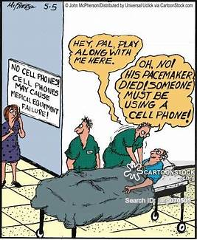
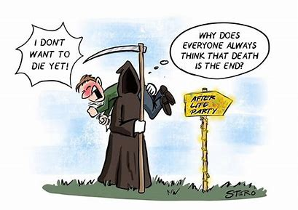

Slide 3
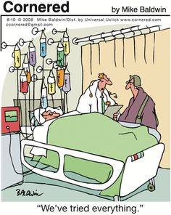

Slide 4
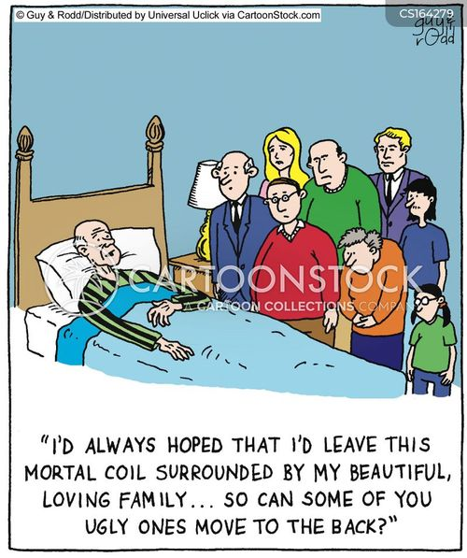
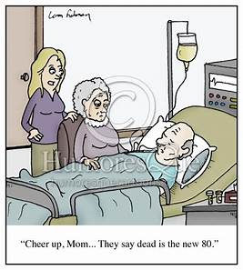
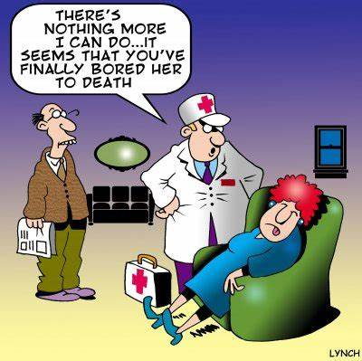
Death and Dying

Slide 5
Objectives
By the end of the study, students should be able to:-
  Define death and dying
  Identify the stages of dying
  Describe the process of dying
  Describe the physiological signs of death and dying
  Describe the care of death and dying

Slide 6
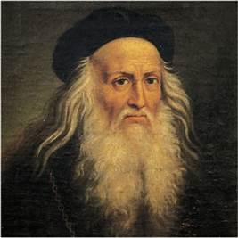
“As a well-spent day brings happy sleep, so a life well used brings happy death”
Leonardo Da Vinci

Slide 7
Introduction
Birth and death are two aspects of life, which will happen to everyone.
Dying and death are painful and personal experiences for those that are dying and their loved ones caring for them.
Death affects each person involved in multiple ways, including physically, psychologically, emotionally, spiritually, and financially.

Slide 8
Definition
Death is defined as “The irreversible cessation of all vital functions especially as indicated by permanent stoppage of the heart, respiration, and higher brain function”
Dying means “approaching death”

Slide 9
Stages of Death and Dying
Although each person reacts to impending death or loss in his or her own way, there are similarities in the psychosocial responses to the situation.
According to Kubler-Ross, there are 5 stages of dying
○ Denial
○ Anger
○ Bargaining
○ Depression
○ Acceptance “DABDA”

Slide 10
Stage 1: Denial
Refusing to believe a probable death will occur. “NOT ME”!!
There is initial reaction of shock “No I donot belive it” “An error has been made on the tests”
You can help others face it by being available for them to talk instead of forcing them to talk about it.
Patient isolates self from source of accurate information, not to seek treatment or assistance.
He never talks about dying and death. He refuses hospital admission and treatment.
Patient appears to be superficially happy to deny the truth of diagnosis

Slide 11
Stage 2: Anger
- Recognition of loss or death - May become angry, frustrated and irritatble that they are sick - “Why me” ??- Anger at God for not allowing them to see their kids grow up - Anger at the doctors, family, self, fate, - Blame everybody for his misfortunes –
Try not to take it personally. They have a right to be angry so allow them to express themselves so they can move on in the grieving process.

Slide 12
Stage 3: Bargaining
The patient attempts to make deal with someone or something to prevent loss
They may start to negotiate with God i.e. “I’ll live a healthier life,” “I’ll be a nicer person,”
They may negotiate with the doctor by saying, “How can I get more time so I can live in my dream home, and so on.

Slide 13
Contd…
There is a deep sense of yearning at this stage to be well again.
This is the time when the wishes are so strong that it seems actually to prolong his her life until his/her wish is fulfilled.
“I know I am going to die, and I am ready to die bu not just yet”
“If I can live longer to attend my son’s wedding”

Slide 14
Stage 4: Depression
When reality sets in about their near death, bargaining turns into depression.
Realises the death.
Looks sad by thought, withdraws from important relationship.
Normal part of the process of preparing to die

Slide 15
Contd…
Guilt for demanding so much attention and depleting the family income occurs.
Patient shows clinical signs of depressionwithdrawal, psychomotor retardation, sleep disturbances, hopelessness and possibly suicidal ideation.
Be available to listen instead of cheering them up.
Distraction is good but don’t ignore the situation.

Slide 16
Stage 5: Acceptance
When the dying have enough time and support, they can often move into acceptance.
Realises the death is inevitable and accepts universality of experience.
Patient begins to make a plan fo his death. Eg. Write a will, completes financial arrangements for family, giving up personal possessions etc.

Slide 17
Contd…
The dying person will want someone caring, and accepting by their side.
People with strong religious beliefs and those who are convinced of life after death can find comfort in these belief

Slide 18
Care of Dying
To provide effective care of dying individual nurse must have reconciled his or her own feelings about death and must understand the phases of grieving & dying and should be able to recognize their manifestations.
Every person has the right to die with dignity.
Caring allows the people to die with dignity.

Slide 19
Ctd…
Nurse must understand the influence of dignified death and the profound effect it has on the family and those close to the person who has died
Ensuring a good death for all is therefore a major challenge not only for healthcare professionals but also for society

Slide 20
Care of Dying…
1. Meeting the needs of dying individual.
Physical needs.
Psychological needs.
Spiritual needs
2. Assessing needs
3. Explaining the clients condition and treatment
4. Maintaining good communication
5. Promoting self care & self esteem
6. Allowing family members to assists in care.

Slide 21
Care of Dying…
Assess the following:
  Gather complete set of data regarding state of awareness manifested by client and family members.
  In cases of terminal illnesses, the state of awareness shared by the client and family affects the nurse’s ability to communicate freely with the client and other health care team members and to assist the family in grieving process.

Slide 22
Ctd…
Assessment of the physiological signs of approaching death:
  Slowed body function.
  Drowsiness, mental confusion become apparent.
  Withdrawal and decreased socialisation, sleep more

Slide 23
Ctd…
Loss of bowel and bladder control.
Cold skin.
Secretions collect in the back of throat and rattle or gurgle as the patient breathes.
Breathing may become irregular with periods of no breathing

Slide 24
Involuntary movements called myoclonus, change in heart rate, loss of reflexes
The patient become restless
He maynot be responsive, vision and hearing may become somewhat impaired and speech become difficult to understand.
As death nears, the pulse become rapid and weaker, pale skin, eye stare and pupil donot respond to light

Slide 25
Physical Care
Providing comfort to the patient and relieving pain.
As patients become weaker they find it increasingly difficult to take oral drugs.
Discontinue drugs that no longer contribute to patient comfort like withdrawing blood, measurement of vital signs, continuing Iv fluids, tube feeding

Slide 26
Regular observations should be made and good symptom control maintained, including control of pain and agitation
Attention to mouth care is essential in the dying patient, and the family can be encouraged to give sips of water or moisten the patient's mouth with a sponge
Turning the patient, eye care, positioning to facilitate drainage of secretions

Slide 27
psychological Care
Patients' insight into their condition should be assessed. Issues relating to dying and death should be explored appropriately and sensitively.
Talk with the dying person and hear them.
Use your mind, eyes and ears to listen them

Slide 28
Ctd…
Respond to his concerns
Appreciate the patients. Never force communication
Honour their wishes even if u don’t agree with them
Need for privacy
Acknowledge them and provide a caring touch or hand holding that offer a comforting message

Slide 29
Social Care
The family's insight into the patient's condition should be assessed and issues relating to dying and death explored appropriately and sensitively.
Prepare the family for the normal, expected change.
If they have been prepared for death, families are less likely to be panic and and better able to be with their loved ones in a meaningful way

Slide 30
Ctd…
Use therapeutic communication to facilitate their expression of feeling.
Allow presence of loved ones and allow time to share with spouse and children his feeling.
Allow him to complete his unfinished work

Slide 31
Showing empathetic and caring presence conveys positive message to the grieving family.
The nurse must have a calm and patient manner.
Repeated information may need as the family members are going through the grieving process. They may not absorb what they are told

Slide 32
Spiritual Care
Religion is a prime source of strength to many people when they are dealing with the death.
Different religious theories explain the inevitability and even necessity of death from different perspective.
Cultural influences can significantly impact the patient’s reaction to the dying process and the decision the family and patient make

Slide 33
Ctd…
The nurse has a responsibility to ensure that the client’s spiritual needs are attended to, either through direct intervention or by arranging access to individual who can provide spiritual care.

Slide 34
Ctd…
Specific interventions include facilitating expressions of feelings, prayer, meditation, reading and discussion with an appropriate clergy or a spiritual advisor.
It can also be helpful, where possible, to ask the dying person where they want to die, who they want to be present at the time of death, and how their cultural/spiritual/individual needs can be met.

Slide 35
References
Berman, J., A., Snyder, S., (2014), Kozier and Erb’ s Fundamentals of Nursing, 9th Edition, Pearson
Potter, A., P., & Perry, G., N., (2011), Fundamentals of Nursing, 7th Edition, Elsevier
Nursing Reviews [Online] Available from: http://currentnursing.com/reviews/care_of_dying_and_death.ht ml [Accessed: 17th November 2015].
Henry, C, Wilson, J. (2012) Personal care at the end of life and after death. Nursing Times; 108: online issue. Available from http://www.nursingtimes.net [Accessed: 17th November 2015]
Wilson, J., White, C. (2012). Guidance for staff responsible for care after death (last offices) Developed by the National End of Life Care Program and National Nurse Consultant Group (Palliative Care). RCN. Available from
http://www.nhsiq.nhs.uk/media/2426968/care_after_death_gui dance.pdf [Accessed: 17th November 2015].

