Slide 1
MSB 102
Ethics in Research and Health Care Practice

Slide 2

What is ethics?
The discipline of dealing with what is good and bad, with moral duty and obligation
A set of moral principles or values
The principle of conduct governing an individual or group
Webster’s Ninth New Collegiate Dictionary

Slide 3
Application of Ethics
Research practice
Health care practice

Slide 4
Ethics in Research Practice

Slide 5
Why it is important to adhere to ethical norms in research
Norms promote the aim of research, such as knowledge, truth, and avoidance of error.
For example, prohibition against fabricating, falsifying, or misrepresenting research data promotes the truth and minimizes error.
Since research often involves cooperation and coordination among many different people in different disciplines and institutions, ethical standards promote the values that are essential to collaborative work.
Such values include trust, accountability, mutual respect, and fairness.
Ethical norms help to ensure that researchers can be held accountable to the public.
For example, policies on research misconduct, conflicts of interest, human subjects protection, animal care and use, are necessary in order to make sure that researchers who are funded by public money can be held accountable to the public.

Slide 6
Why it is important to adhere to ethical norms in research
4. Ethical norms in research also help to build public support for research.
People are more likely to fund a research project if they can trust the quality and integrity of research.
5. Norms promote other important moral and social values
Such moral and social values include social responsibility, human rights, animal welfare, compliance with the law, and public health and safety.

Slide 7
Codes and policies for research ethics
National Institutes of Health (NIH)
National Science Foundation (NSF)
Food and Drug Administration (FDA)
Environmental Protection Agency (EPA)
US Department of Agriculture (USDA)
Singapore Statement on Research Integrity
American Chemical Society, The Chemist Professional’s Code of Conduct
Code of Ethics (American Society for Clinical Laboratory Science)
American Psychological Association, Ethical Principles of Psychologists and Code of Conduct
Statement on Professional Ethics (American Association of University Professors)
Nuremberg Code
World Medical Association's Declaration of Helsinki

Slide 8

The Nazi Experiment
World War II
Purpose: To conduct extreme experiments
Subjects: Concentration camp prisoners
Problems:
prisoners were engaged in research without consent,
did more harm than good,
death and injury was part of outcomes to be observed……
Led to Nuremberg Trial (1947)

Slide 9
The Nuremberg Code (1947)
Informed and voluntary consent is absolutely essential
Qualified researchers must use appropriate research designs
Scientific rigor
There must be a favorable risk/ benefit ratio
Death or serious injury should NOT be an expected outcome
Participants must be free to stop at any time

Slide 10
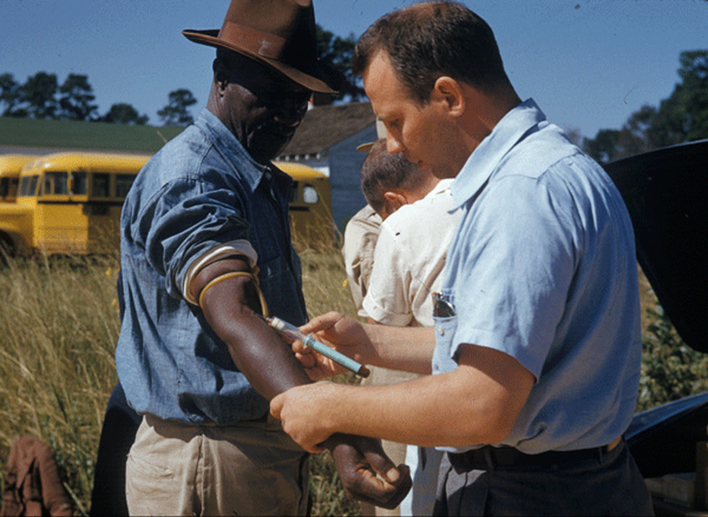
Tuskegee Syphilis Study
1932-1972 (US Public Health Service)
Purpose: To determine natural course of syphilis over time
Subjects: Poor African-American men
Problems:
Deception
Appropriate treatment withheld
Led to Belmont Report

Slide 11
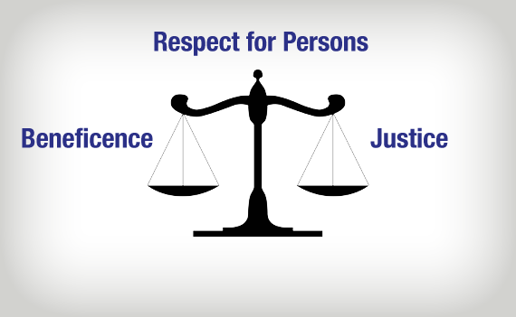
The Belmont Report
The U.S. National Commission for the Protection of Human Subjects of Biomedical and Behavioral Research, 1978
Ethical Principles and Guidelines for the Protection of Human Subjects of Research:
Respect for persons
Beneficence
Justice

Slide 12
Application of the ethical principles in Research
Respect for persons
Autonomy
Privacy
Confidentiality
Beneficence
Benefits and risks
Risks are reasonable in relation to benefits
Prevent harm, disability
Justice
Participants selection
Fairness in selection
Equality and equitable treatment
Access

Slide 13
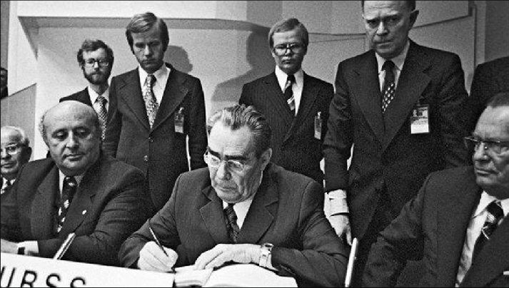
The Declaration of Helsinki: World Medical Association (1964, 1975, 1983, 1989, 1996, 2002)
“The well-being of the subject should take precedence over the interests of science and society”
Consent should be in writing
Use caution if participant is in dependent relationship with researcher
Limited use of placebo, especially if treatment is available
Greater access to benefit once research is concluded

Slide 14

Human participants protection
When conducting research on humans:
minimize harm and risks and maximize benefits
respect human dignity, privacy, and autonomy
take special precautions with vulnerable populations
strive to distribute the benefits and burdens of research fairly.

Slide 15
Who oversees research ethics
Institution research boards (IRB)
National research boards: NACOSTI
Hospital research boards
Academic research boards:-MTRH/MU IREC
A combination of hospital and research boards
National Commission for Science, Technology and Innovation (NACOSTI)
The national legal entity authorized to review and approve research in Kenya under the Science Technology and Innovation Act No. 28 of 2013.
Moi University IRB
The Moi Teaching & Referral Hospital / Moi University College of Health Sciences -Institutional Research and Ethics Committee(MTRH/MU-IREC): constituted jointly by Moi Teaching & Referral Hospital (MTRH) and Moi University College of Health Sciences (MUCHS).
Reviews and approves research on behalf of NACOSTI.

Slide 16
Role of IRB
Primary responsibility is to protect rights and welfare of human research participants
Review, evaluation and approval of proposed research involving humans, their tissue and related data based on the scientific and ethical merits of research proposals
(i) Expedited Review– Research investigations that present no more than minimal risk to the study participants and minor amendment in previously approved research during the period for which approval was granted.
(ii) Full Review– All other research proposals submitted for review and which do not meet the criteria for expedited and exempt review undergo the process of a full review. (iii) Continuing Review– All approvals are valid for a period of one year. studies that last for more than one year apply for a continuing approval annually. (iv) Exempt Review– Unless otherwise defined by the committee and other relevant regulations, research activities in which the only involvement of human subjects will be in one or more of the following categories are exempt from these SOP’s (v) Review or amendments to a previously approved Proposal– All amendments to approved study proposal are previewed by IREC members before the amended protocol is implemented.
Monitor of the approved studies with the aim of safeguarding the dignity, rights and welfare of the research participants.

Slide 17
IRB regulation
Risks to subjects are minimized
Risks are reasonable in relation to potential benefits
Selection of subjects is equitable
Informed consent will be sought and documented for each subject
Ongoing monitoring will occur to ensure subject safety
Adequate provisions exist to protect privacy
Special safeguards are in place for vulnerable subjects

Slide 18
IRB composition
At least 5 members
At least one “scientist” member
At least one “non-scientist” member
At least one member who is otherwise unaffiliated with the institution
At least one member who is considered a “participant advocate.”
Diversity regarding gender, background, etc. to represent the types of research reviewed

Slide 19

Prior to Beginning the Study
Seek approval from the institutional review board (IRB)
IRB committees provide protection against human rights violations
IRBs review the extent to which participants are placed at risk in your study
Tips for obtaining ethics approval at a minimum time
Allow time
Communicate clearly
Ensure your application is self-explanatory
Use the guidelines available to help you
Ensure your application package is complete
Label your documents
Place yourself in the place of your participants
What issues and concerns might you have about the project before agreeing to participate and what information and reassurances would you want a researcher to provide.

Slide 20

Beginning the Study
Obtain necessary permissions
Gain local permission from site and participants
Identify & go through local approvals. Find gatekeepers/key personnel to help
Specify the;
extent of time of the research,
the potential impact of the research, and
the potential outcomes of the research
Disclose purpose of the study.
Contact participants & inform them of the general purpose of the study
Convey to the participants the purpose of the study as per the research protocol
Participants should sign informed consent forms before they provide data
Consent forms contains a standard set of elements that acknowledges protection of human rights including;
Identification of the researcher
Identification of the sponsoring institution
Identification of the purpose of the study
Identification of the benefits for participating
Identification of the level and type of participant involvement CONT…

Slide 21
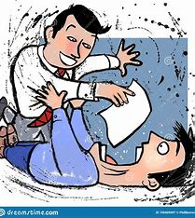
Cont…Beginning the Study
CONT…
Notation of risks to the participant
Guarantee of confidentiality to the participant
Assurance that the participant can withdraw at any time
Provision of names of persons to contact if questions arise
Do not pressure participants into signing consent forms
Tell the participants that they do not have to sign the consent form
Inform participants of the voluntary nature of participation
Respect norms and charters of indigenous cultures
Find out about cultural, religious, gender, and other differences in the participants and sites that need to be respected

Slide 22
Informed Consent

Slide 23

Informed Consent
The CIOMS guidelines state that informed or valid consent must address three questions:
Does the patient have the capacity to consent requiring consideration of such issues as age, maturity, cognitive ability;
Is the consent voluntary (i.e., is the decision made free from coercion, inducement, or intimidation including pressure from a family member, physician); and
Has the patient received sufficient information on which to base his/her decision?

Slide 24
Informed consent
A consent is a process not an event
Provide the participant with enough information and opportunity to ask questions
Avail information in appropriate language and in a written style understood by the participant – consider the context
Consent process must be documented
The use of biologic materials, including possible storage and future use – whether the material will be anonymized or not, needs to be openly discussed.

Slide 25
Obtaining informed consent involves
Providing information to the subject in a language that is understandable to the subject or their representative
Ensuring that the subject understands what they are being asked to do
Answering any questions that the subject may have
Allowing enough time for the person to think about the research before consenting to participate
Obtaining voluntary agreement of the subject to participate in the study

Slide 26
Elements of an Informed Consent
Information that the study involves research
Risks or discomforts
Benefits
Alternatives
Confidentiality
Compensation/treatment offered
Contact for additional information
Contact information for research subject rights
Statement that participation is voluntary

Slide 27
Checklist for informed consent
□ Inform the subject why they are being approached.
□ Ensure that consent in voluntary.
□ Explain freedom to withdraw.
□ Explain the purpose of the research.
□ Describe the trial design in lay terms.
□ Explain duration of participation required.
□ Discuss any remuneration.
□ Discuss mechanisms to inform participants of study results.
□ Notify participant of confidentiality arrangements and safeguards about access to individual data.
□ Confirm ethical review has been obtained.
□ Discuss foreseeable risks.
□ Discuss possible benefits to the individual or community.
□ Will the treatment be available after study completion?
□ What are the alternative treatments to study medication or therapy?
□ Are any secondary studies proposed?
□ Is there a distinction between the role of the investigator and the patient's physician?
□ Are medical services provided for the subject during the study?
□ Explain what arrangements have been made to deal with research-related injury.
□ How will the subject be compensated in the event of research-related injury?
https://www.atsjournals.org/action/showPopup?citid=citart1&id=TBL4&doi=10.1513%2Fpats.200701-011GC

Slide 28
Informed Consent details in the proposal
The proposal should detail:
Where and from whom ethical approvals will be obtained
Institutional administrative approval
Consent from Participants with focus on the checklist items
Written vs verbal consent
For children be sure to have a parental consent as well as assent from the child
Don’t assume that the parent/guardian consent will suffice
Write in simple language for a child’s understanding – do not hide information from the child
Use this table to decide participation
 |  | Parent
 |  | Yes | No
Child | Yes | YY | YN
 | No | NY | NN

Slide 29

Collecting the Data
Respect the site, and disrupt as little as possible
Build trust & convey extent of anticipated disruption in gaining access
Be cognizant of your impact & minimize your disruption of the physical setting
E.g. Time your visits so that they intrude little on the flow of activities of participants
Avoid deceiving participants
Truthfully discuss purpose of the study and how data will be used
Let participants know that they are actively participating in a research study
Respect potential power imbalances
Avoid leading questions
Withhold sharing personal impressions
Avoid disclosing sensitive information

Slide 30
Ethics in Health Care Practice

Slide 31
Ethics in health care practice
This is guided by the Professional and Ethical Practice
Our care for patients should be based on sound judgement or evidence based practice!!
..some of this judgement is about having a strong sense of what is right or wrong
..having a strong sense of what we should be doing and shouldn’t be doing
..having a strong sense of what our priorities ought to be

Slide 32
Ethics in health care practice
This is a dynamic ongoing process:
When you have to judge what is right or wrong
Choosing between options
Deciding whether to do something or do nothing
Should I or shouldn’t I?
Weighing up the potential impact of your decisions or actions
A dilemma – making a difficult choice

Slide 33
Key principles in ethics in health care practice
Autonomy
Respect a person’s right to make their own decisions
Teach people to be able to make their own choices
Support people in their individual choices
Do not force or coerce people to do things
‘Informed Consent’ is an important outcome of this principle
Beneficence
Our actions must aim to ‘benefit’ people – health, welfare, comfort, well-being, improve a person’s potential, improve quality of life
‘Benefit’ should be defined by the person themselves. It’s not what we think that is important.
Act on behalf of ‘vulnerable’ people to protect their rights
Prevent harm
Create a safe and supportive environment
Help people in crises

Slide 34
Key principles in ethics in health care practice
Non-maleficence
do not to inflict harm on people
do not cause pain or suffering
do not incapacitate
do not cause offence
do not deprive people
do not kill
Justice
Treating people fairly
Not favouring some individuals/groups over others
Acting in a non–discriminatory / non-prejudicial way
Respect for peoples rights
Respect for the law

Slide 35
Guiding ethical rules in health care practice
Veracity – truth telling, informed consent, respect for autonomy
Privacy – a persons right to remain private, to not disclose information
Confidentiality – only sharing private information on a ‘need to know basis’
Fidelity – loyalty, maintaining the duty to care for all no matter who they are or what they may have done

Slide 36
References
Hunt G (1994) Ethical Issues in Nursing Routledge. London
Seedhouse D (1998) Ethics the heart of Health Care Wiley. Winchester.
http://www.iep.utm.edu/e/ethics.htm#SH2a
http://www.nursingethics.ca/articles.html
http://www.freedomtocare.org/iane.htm
http://www.lib.flinders.edu.au/resources/sub/healthsci/a-zlist/ethics.html

Slide 37


