Slide 1
MSB 102
Medical Sociology

Slide 2
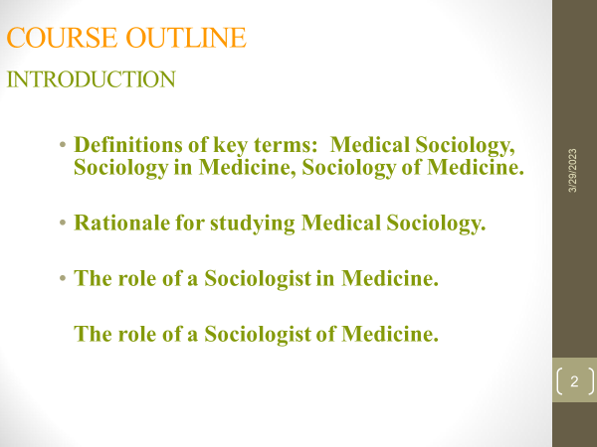
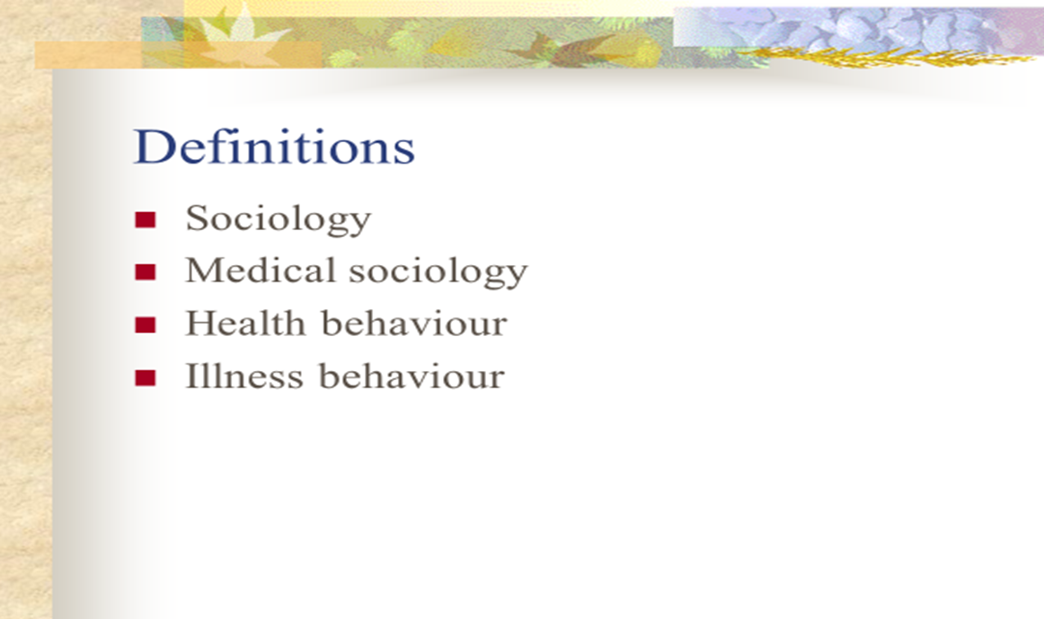

Slide 3
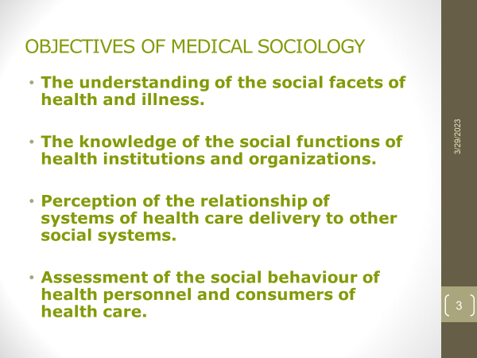
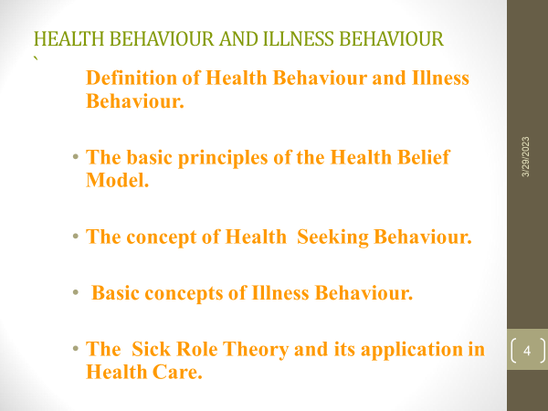

Slide 4
WHO Definition-Health
“Health is a state of complete physical, mental and social wellbeing and not merely an absence of disease or infirmity.”
now added
“the ability to lead a socially and economically productive life.”
The concept of health as defined by WHO is broad and positive in its implications; it sets out the standard, the standard of “positive” health.

Slide 5
WHO Definition-Health
Traditionally health has been considered as an absence of the diseases and if someone was free from disease, then that person was considered healthy.
This concept is known as biomedical concept, and it has a basis on the
“germ theory of the disease.”

Slide 6
Changing Concepts Of Health
Health is perceived in different ways giving rise to various concepts of health.
Health has evolved over the centuries as a concept from an individual concern to a worldwide social goal.

Slide 7
Changing Concepts Of Health
1. Biomedical Concept
Health means “absence of disease.”
It was felt that human body is a machine and disease is an outcome of the breakdown of the machine, and one of the doctor’s tasks was to repair the machine.
Developments in medical and social sciences led to the conclusion that the biomedical concept of health was inadequate.
2. Ecological Concept
Ecologists viewed health as a dynamic equilibrium between man and his environment, and disease – a maladjustment of the human organism to environment.

Slide 8
Changing Concepts Of Health
3. Psychosocial Concept
Advances in social sciences showed that health is not only a biomedical phenomenon, but one which is influenced by social, psychological, cultural, economic and political factors of the people concerned.
Thus health is both a biological and social phenomenon.
4. Holistic Concept
Holistic concept recognizes the strength of social, economic, political and environmental influences on health.
It has been variously described as multidimensional process involving the wellbeing of the person as a whole
The emphasis is on the promotion and protection of health.

Slide 9
Dimensions Of Health
Health is multidimensional and are interrelated, each has its own nature
Physical Dimension
“Perfect functioning” of the body.
It conceptualizes health biologically as a state in which every cell and every organ are functioning at optimum capacity and in perfect harmony with the rest of the body.
Intellectual Dimension
The intellectual dimension recognizes one’s creative, stimulating mental activities. A well person expands his or her knowledge and skills while discovering the potential for sharing his or her gifts with others.

Slide 10
Dimensions Of Health
Social Dimension
Harmony and integration with the individual, between each individual and other members of society, and between individuals and the world in which they live.
“quantity and quality of an individual’s interpersonal ties and the extent of involvement with the community.”
Spiritual Dimension
Spiritual health refers to “something” that exceeds physiology and psychology.
The spiritual dimension recognizes our search for meaning and purpose in human existence. It includes the development of a deep appreciation for the depth and expanse of life and natural forces that exist in the universe.

Slide 11
Emotional Dimension
Relates to “feeling.” it reflects emotional aspects of humanness. The emotional dimension recognizes awareness and acceptance of one’s feelings.
Emotional wellness includes the degree to which one feels positive and enthusiastic about one’s self and life.
It includes the capacity to manage one’s feelings and related behaviors including the realistic assessment of one’s limitations, development of autonomy, and ability to cope effectively with stress.
Vocational/Occupational Dimension
Work often plays a role in promoting both physical and mental health.
Physical work is usually associated with an improvement in physical capacity, while goal achievement and self-realization in work are a source of contentment and enhanced self-esteem.
Dimensions Of Health

Slide 12
Concept Of Wellbeing
Standard of Living
As per WHO, “Income and occupation, standards of housing, sanitation and nutrition, the level of provision of health, educational, recreational and other service and collectively as an index of the ‘standard of living’.”
Level of Living
As per United Nations documents “level of living” consists of nine components: health, food consumption, education, occupation and working conditions, housing, social security, clothing, recreation and leisure, and human rights.

Slide 13
Concept Of Wellbeing
Quality of Life
Quality of life as defined by WHO, “The condition of life resulting from combination of the effects of the complete range of factors such as those determining health, happiness , education, social and intellectual attainments, freedom of action, justice and freedom of expression.”
Physical Quality of Life Index
It includes three indicators such as
Infant mortality
Life expectancy at age one
Literacy.

Slide 14
Concept Of Wellbeing
Human Developmental Index includes
  longevity (life expectancy at birth)
  knowledge (adult literacy rate)
  income (real GDP per capita)

Slide 15
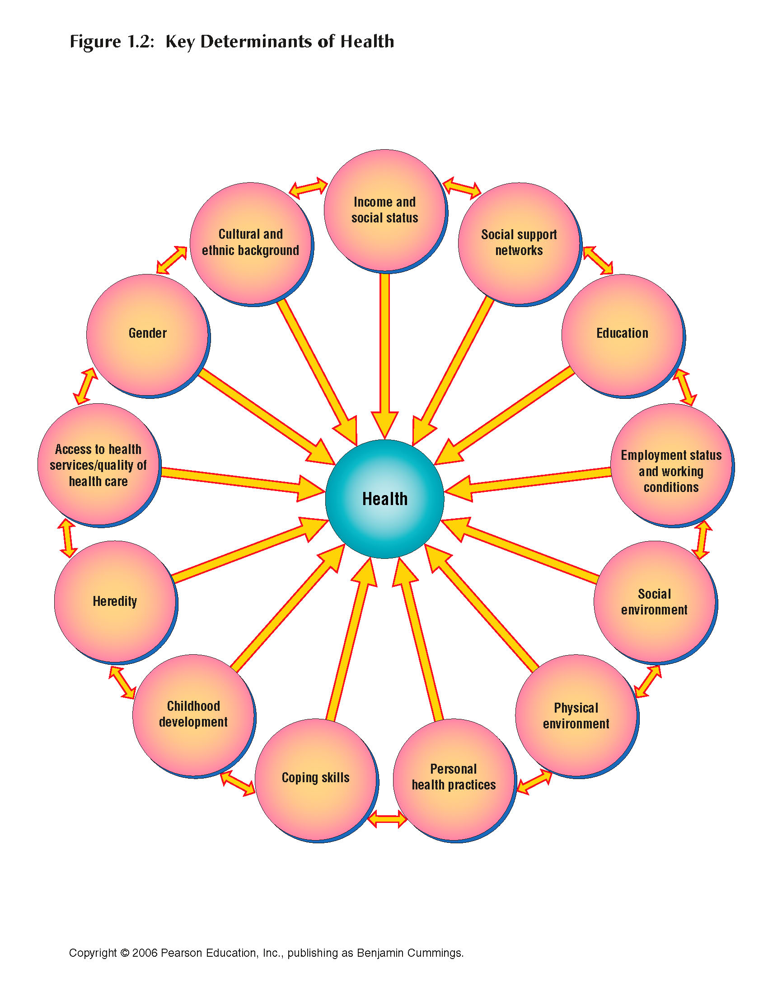
Key Determinants of Health

Slide 16
Early childhood development
The life course perspective emphasizes that early experiences have a profound formative impact on an adult.
Early nutrition, physical development and fitness are important, as is emotional development which, if positive, builds resiliency, and if negative, enhances vulnerability.
Timing of exposures and experiences can be critical. For example, traumatic experiences in early childhood shape personality and have a lasting impact on how a person views his world, how he relates to others, and how he interprets events.
The impact of broken homes, chronic childhood stresses and so forth have non-specific effects, acting mainly to increase emotional vulnerability in adult life.

Slide 17
Income and social status
A person’s social status is defined by a combination of their wealth, education, occupation and lifestyle, and (secondarily and to a varying extent) by other factors such as ethnicity, personality, and happenstance.
Each of these, alone or in combination, can exert positive or negative influences on a person’s health.
Whatever marker of social status is used (wealth, education, occupation, or power), and whatever the health indicator (longevity, death rates, morbidity, or self-reported distress), there is a universal tendency for those in higher social positions to enjoy better health.
Exceptions are rare and often transient (an example occurred in the 1930s, when heart disease was on the rise, and cases often occurred in richer people who could afford a cardiogenic diet and sedentary lifestyle. Subsequently, the decline in heart disease has occurred more steeply among richer people so that the familiar social class gradient now holds).

Slide 18
Education and literacy
Education is one of many characteristics that both contribute to, and also result from, social position.
A person’s social position in childhood influences their access to educational opportunities.
The resulting education influences their social position in various ways: by its impact on employment opportunities, by determining their income, and by influencing whom they meet and where they live.
Education also has a more direct influence on health in that it affects a person’s ability to navigate the health care system, to interpret health information and to communicate effectively with physicians and other professionals.
Health literacy’ refers to the patient’s ability to understand health information and to follow guidelines for their treatment. Physicians need to be aware that a large fraction of their patients may not be able to understand information concerning their health in the format that it is given.

Slide 19
Social support networks
Social support is beneficial to the overall wellbeing of a human being.
It is a source of emotional reassurance and provides a safe place for a person to discuss his/her problems, which helps him to cope with adversity.
The same association between social ties and health holds at the population level: healthy communities establish collaborative networks that help them address social and economic issues.
Social capital refers to people’s willingness to collaborate in groups and engage in collective action, which in turn reinforces trust and confidence within the networks; neighbourhood watch programmes are an example.

Slide 20
Employment, working conditions, and occupational health
The field of occupational health involves the management and prevention of occupational diseases and injuries, as well as the improvement of work settings in general. It is based on the simple idea that work and health influence each other, at times positively and at times negatively.
Occupational diseases are disorders that result from conditions in the workplace, typically from exposures to physical, chemical, and perhaps psychological hazards. Asbestos exposure leading to mesothelioma is an example.
Occupational injuries mainly result from mechanical factors, such as lifting or bending, or from failures in safety measures. The lower a worker’s income, the more likely they are to experience a work-related injury.

Slide 21
The physical environment
Environmental influences on health can be positive or negative, and cover a wide range of factors, from global (climate change) to national and regional issues (economic recessions, strife, air, and water pollution) to issues in the local built environment (indoor air quality), to the social environment.
The positive benefits of spending time in beautiful surroundings are well understood.
Exposures to contaminants in air, water, food and soil, are associated with many chronic diseases and with emerging communicable diseases.
Climate change and the associated weather extremes will also affect health: hyperthermia from extreme heat, injury from extreme wind and rain, social disruption from sea level change and agricultural effects, and changing distribution of vectors and infectious agents introduce disease to previously unaffected regions.
Design of the built environment also influences health. Overcrowding in housing and community design (which affects transportation and neighbourhood walkability) are increasingly identified as risk factors for chronic diseases, especially respiratory conditions.
As people live further from the city centre they drive more, resulting in more vehicle collisions, "as well as higher rates of heart and respiratory diseases and obesity, and elevated stress related to both commuting among congested traffic and increased noise levels."

Slide 22
Health Services
Advances in health care have conferred immense benefits on health and longevity for countries of the developed world and in many developing countries. Hence availability and access to health services are important for the health status of individuals in a country.
The invention of antibiotics, antisepsis, life-saving surgical procedures, as well as advances in pharmaceuticals, have all revolutionized the management of a wide range of diseases.
At the population level, public health interventions (sanitation, communicable disease control measures, etc.) and disease prevention (immunization, tobacco control measures, and screening) have made major contributions to saving lives and improving health.
Historical declines occurred for polio, smallpox, and whooping cough, all of which responded dramatically to improvements in hygiene long before effective medical treatments were developed.

Slide 23
Gender
Because of social (gender) and biological (sex) differences, women and men face different health risks, experience different responses from health systems, and their health-seeking behavior, and health outcomes differ.
Women are more likely to have certain diseases compared to men. Example breast cancer, cervical cancer (only in women),
Men are also likely to have a higher risk of certain diseases compared to women. Example, heart diseases, respiratory diseases, prostate cancer (only in men).
In most societies women have less access to health information, care, services and resources to protect their health.
Gender norms also affect men’s health by assigning them roles that promote risk-taking behavior and cause them to neglect their health e.g. drinking
Women’s health is gaining importance in areas such as nutrition, health consequences of violence, aging, lifestyle related conditions and the occupational environment.
Internationally the development goals contained in the Millennium Declaration include the promotion of gender equality and the empowerment of women as effective ways to combat poverty, hunger and disease and to stimulate sustainable development.

Slide 24
Culture
"Culture is a system of ideas, values, and metaphors that are consciously and unconsciously used or enacted by people in their everyday lives. It is not a rigid set of behaviour traits but a fluid and adaptive system of meaning.
Culture explains what one must know and do to function in a given society.
Culture also underpins values, which are deeply held beliefs that define what is desirable and moral.
Culture may negatively influence health such as female genital mutilation, wife beating, wife inheritance.
Culture could also positively influence health such as eating indigenous foods, promoting social health etcs
Interventions designed to support healthy behaviours have been most successful when they consider the culture of the target population and when the community is actively engaged in designing and implementing the intervention.
However, although cultures may be shared, people are far from homogeneous, and it is dangerous to assume that all people defined as belonging to a certain culture will hold the same norms and values or will react the same way to new ideas and knowledge.

Slide 25
Combinations of determinants
Different determinants often occur in association in individuals and in communities. For instance, a person with little education is likely have an unsatisfactory, poorly paid job and to live in poor housing. At the community level, the neighborhood in which this person lives is likely to be undesirable, perhaps near an industrial complex with heavy traffic. It unlikely to have many services close by and, having little social cohesion, it is unlikely to develop enough political power to force improvements.
This aggregation makes it difficult to tease out the individual determinants that are linked with individual health outcomes.
Furthermore, the different determinants can create feedback loops. For instance, overcrowded housing causes increased transmission of infection which causes increased time off work which causes decreased income which forces people to live in overcrowded housing.
This idea of multiple associations, links and feedback loops is known as the web of causation.

Slide 26
Indicators Of Health
Indicators should be valid, reliable and objective, sensitive, specific, feasible and relevant.
    1. Morbidity indicators
    2. Disability rates
    3. Nutritional status indicators
    4. Health care delivery indicators
    5. Utilization rates
    6. Indicators of social and mental health
    7. Environmental indicators
    8. Socioeconomic indicators
    9. Health policy indicators
    10. Indicators of quality of life
    11. Other indicators

Slide 27
Sociology: Is the scientific study of human society, social relationships and social behavior.
Medical Sociology: Is a subfield of sociology that focuses on the social aspects of health, illness and healthcare systems
Sociology in Medicine: Focuses on how medicine and healthcare institutions affect society. It examines the social organization of healthcare, the role of healthcare providers, the influence of medical technology and impact of healthcare policies on society. E.g. A sociologist might study how medical knowledge is produced and disseminated or how the structure of healthcare system affects access to care.
Sociology of Medicine: Focuses on how society affects health, disease and health care. It examines the social behaviors that shape people`s health behaviors, access to healthcare and experiences with illness. E.g. A sociologist might study how poverty, race, gender and other social factors affect people`s health outcomes or how cultural beliefs and values shape the way people perceive and respond to illness.

Slide 28
Medical Sociology and
Sociological Theory
Medical sociology is a subfield of sociology that focuses on the social aspects of health, illness and healthcare systems.
Medical sociologists examine how social factors e.g. race, ethnicity, gender, socioeconomic status and culture impact health and healthcare outcomes. They also study the social structures and organization of healthcare system including institutions and policies that shape access and quality of care.
Medical Sociology:
  The link between medical sociology and sociological theory is crucial to the sub-discipline. Theory binds medical sociology to the larger discipline of sociology.
  Medical sociology has the capacity for explaining the considerations of health increasingly evident in the everyday social lives of people
  Medical sociology has become increasingly important to medicine because of the key roles of social behavior and living conditions in the prevention, onset, and course of chronic disorders.

Slide 29
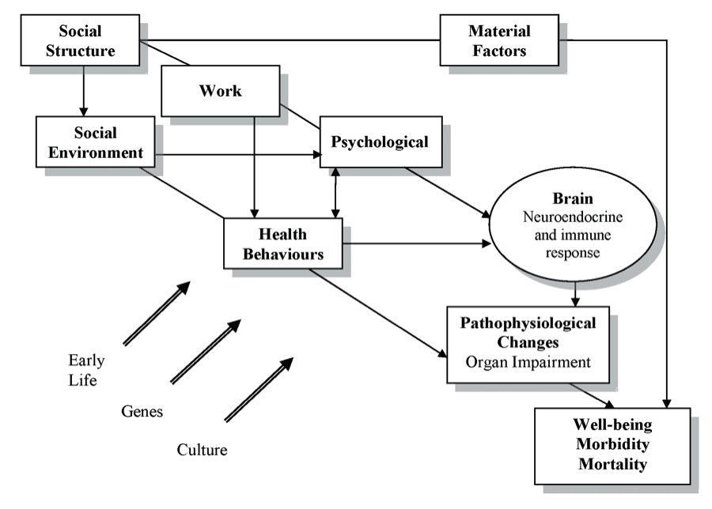
Social Causation/Psychosocial Model
Social Determinants of Health and the Pathways to Health and Illness
Source: Brunner, E., & Marmot, M. G. (2006). ‘Social Organization, Stress, and Health.’ In M. G. Marmot &
R. G. Wilkinson (Eds.), Social Determinants of Health. Oxford: Oxford University Press, Figure 2.2, p. 9.
Notes:
The social gradient in terms of health outcomes showing that large differences exist between the social classes. Those in lowest social class are more likely to die younger and experience higher levels of morbidity. The primary factors that shape the health of Canadians are not medical treatments or lifestyle choices but rather the living conditions they experience. Our health is shaped by how income and wealth is distributed, whether or not we are employed, and if so, the working conditions we experience. Furthermore, our wellbeing is also determined by the health and social services we receive, and our ability to obtain quality education, food and housing, among other factors. People who suffer from adverse social and material living conditions also experience high levels of physiological and psychological stress. Stressful experiences arise from coping with conditions of low income, poor quality housing, food insecurity, inadequate working conditions, insecure employment, and various forms of discrimination based on Aboriginal status, disability, gender, or race. The lack of supportive relationships, social isolation, and mistrust of others further increases stress. At the physiological level, chronic stress can lead to prolonged biological reactions that strain the physical body. People who experience high levels of stress often attempt to relieve these pressures by adopting unhealthy coping behaviours, such as the excessive use of alcohol, smoking, and overeating carbohydrates.

Slide 30
What is Sociology?
Sociology is the scientific study of human society, social relationships and social behavior.
It examines social institutions, cultures and social norms and how they influence human behavior and shape society.
Sociologists use various research methods to study social phenomenon e.g. surveys, experiments, observation and interviews.
Sociology is interested in social processes and how society is structured and works:
  Examines the interactions between macro and micro-level e.g. economy, education and individual behavior.
  How does society influence individuals; how do individuals influence society?

Slide 31
What is Sociology?
Science of Society: originally aligned with positivist science; now spectrum of approaches.
Agency (action) /Structure (features of the social world): systematic study of relationship between individuals and society, and the consequences of differences.
Critical examination of everyday aspects of human life – problematizes taken-for-granted assumptions, “common sense” understandings, and so-called “obvious” explanations of human behavior, health and disease.
Contextualizes individual/personal experience.

Slide 32
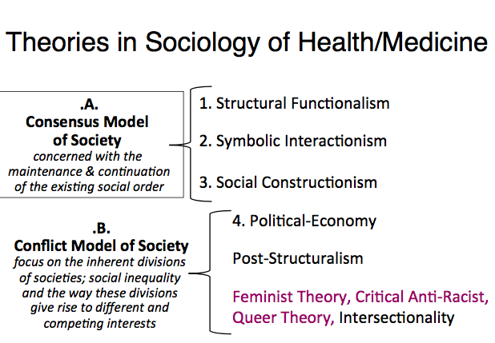
Notes:
Each sociological theory explains society in a different way and therefore health too.

Slide 33
1. Structural Functionalism
School of thought in sociology and anthropology that argues that society should be understood as a system of inter-dependent parts.
The different parts of social life depend on each other and fulfill functions contributing to social order and its reproduction.
Notes:
Explains society as functioning biological organism in which individuals make up the necessary organs to contribute to its smooth running. Society is consensual with everyone doing their bit to keep society running e.g. sickness within society.

Slide 34
Structural functionalism is a theoretical approach in sociology that focuses on the role of social structures and institutions in maintaining social order and stability. According to structural functionalism, society is made up of interconnected parts, each of which serves a specific function that contributes to the overall well-being of the society. These parts include institutions such as the family, education, and the economy, which work together to maintain social stability and ensure that society runs smoothly. One of the key ideas in structural functionalism is the concept of social integration, which refers to the degree to which individuals and groups within society are united by shared values, norms, and beliefs. Structural functionalists argue that the more integrated a society is, the more stable it will be, as individuals and groups will be more likely to cooperate with one another and work towards common goals. Critics of structural functionalism argue that it tends to be overly static and doesn't account for the ways in which societies and social structures can change over time. Additionally, some argue that functionalism places too much emphasis on social order and stability, and not enough on issues of power and inequality. Despite these criticisms, however, the structural functionalist perspective remains an important and influential approach in sociology.

Slide 35
Structural Functionalism
Macro-sociological theory.
Consensualist View of Society: assumes shared values, norms, attitudes, and beliefs.
Social order is maintained by people acting in certain defined roles, performing certain functions.
Illness as Deviance: unnatural state of the human body, causing both physical and social dysfunction.
Medicine is part of a Controlling Apparatus within society that functions to maintain the social order by returning people to health.

Slide 36
Structural Functionalism
EXAMPLE: Talcott Parsons (influential in 1950s – 1960s).
Healthcare: exists to restore and maintain social order.
Health is important if society is to function smoothly; people must be able to perform their roles.
Doctor: socially beneficent, parental role.
Doctor-Patient Relationship: harmonious and, no real power imbalance.
Key Concepts: Sick-Role, Doctor-Patient Relationship.

Slide 37
Structural Functionalism
Sick Role: rights + obligations that surround illness and shape behaviour of the doctor and patient (Gabe et al., 2004, p.91)
When one is ill, one does not simply exit normal social roles to enter a type of social vacuum; rather, one substitutes a new role—the sick role—for the relinquished, normal roles.
The sick role is, “also a social role, characterized by certain exemptions, rights, and obligations, and shaped by the society, groups, and cultural tradition to which the sick person belongs.”
Sick role Theory:
  Exempt from performance of social obligations/Exempt from normal roles
  Not to blame for their condition/Not responsible for the illness
  Must want to try to get well (return to normalcy)/Will to get well
  Must put themselves into the hands of medical professionals to get well.
  Seek professional medical care

Slide 38
SICK ROLE THEORY
Sick role theory is a concept developed by Talcott Parsons. According to this theory, when an individual becomes sick or unwell, they are automatically exempted from their social roles and responsibilities. Instead, they are expected to take on the "sick role", which is characterized by certain rights and responsibilities.
Individuals in the sick role have the right to be taken care of, to receive medical attention, and to not be held responsible for their illness.
On the other hand, they also have a responsibility to seek medical attention, to follow the advice of healthcare providers, and to try to get well as soon as possible so they can resume their social roles and responsibilities.
The sick role theory is relevant in understanding how illness affects individuals, their families, and society as a whole. It also highlights the importance of healthcare professionals in assisting patients to navigate their illness and to help them to return to their normal social lives.

Slide 39
The sick role theory has a significant impact on medicine because it helps to shape the relationship between healthcare providers and patients. Understanding the sick role, which is the temporary shift in social roles and responsibilities that occurs when someone becomes ill, allows healthcare providers to treat patients with empathy and respect. By recognizing that individuals in the sick role have unique rights and responsibilities, healthcare providers can work to help them recover and reintegrate into their normal social roles. The sick role theory also helps healthcare providers to understand why some patients may resist taking responsibility for their own healthcare, and provides a framework for promoting patient compliance. In addition, the theory is useful in understanding the impact of illness on individuals and society as a whole. When people are unable to fulfill their normal social roles, this can have significant economic and social effects. By understanding the sick role, healthcare providers can work to minimize these effects and promote recovery and reintegration into society. Overall, the sick role theory has an important role in shaping the practice of medicine by emphasizing the importance of empathy, patient empowerment, and social context.

Slide 40
Criticism of the Sick Role
The sick role is applicable in describing patient experience with acute illness only and is less appropriate is describing persons with chronic illnesses who may not have easily recognizable symptoms and may not get well no matter how much they want to and how faithful they are in following the physician’s instructions.
The sick role is more applicable to middle‐class patients and middle‐class values than it is for persons in lower socioeconomic groups. Not everyone can follow this pathway; for example, lower income persons have less freedom to curtail their normal responsibilities, especially their jobs, and thus have a more difficult time complying with the model.
The sick role does not account for the considerable variability in behavior among sick persons (age, gender, and ethnicity, certainty and severity of prognosis).
The sick role does not adequately account for the variety of settings in which physicians and patients interact; it is most applicable to a physician‐patient relationship that occurs in the physician’s office.

Slide 41
Critiques of Structural Functionalism
Ignores potential for conflict inherent in the medical encounter
  Patients as compliant, passive, grateful
  Doctors as beneficent, competent, altruistic
  Does not consider negotiation, conflict of interests, power
Moralistic: potential for people to become “malingerers”.
Paternalistic: doctor a father; patient as dis/obedient child.
Decontextualized: disregards importance of context.

Slide 42
2. Symbolic Interactionism
Micro-level of analysis: focuses on individuals subjective experiences; how we interact with one another.
Human action must be interpreted, not simply observed or assumed; qualitative.
Concerned with “insiders” perceptions.
Example: Erving Goffman (stigma), Michael Bury (biographic disruption).
Notes:
Explains social phenomena from the perspective of its participants and so is a micro-analysis of individuals, examining behaviour on a smaller scale. Insider perspective, subjective experiences of illness.
Human action must be interpreted by studying the meanings people attach to their behaviour. What meanings are attached to illness behaviour? This depends on the illness being experienced as some illnesses have negative meanings attached to them. E.g. Stigma.

Slide 43
Symbolic Interactionism
Labelling Theory & Stigma
Erving Goffman argued labelling has VIP social consequences.
Stigma: a powerfully negative label that changes a person’s
self-concept and identity.
Illness can impact human identity through stigma.
Judgments made about health/illness are value laden; reflect norms of a given time and place; thus some illnesses are stigmatizing.
Many illnesses are stigmatized, examples: mental illness, visible disfigurement and disability, HIV/AIDS.

Slide 44
Symbolic Interactionism
Biographical Disruption
Proposed by Michael Bury; seminal study of people living with rheumatoid arthritis.
Chronic disease as a form of biographical disruption – when experience of illness disrupts a person’s life.
Potentially challenges and destabilizes a person’s identity.
However, not always negative, example, biographical reinforcement – reinforcing parts of a person’s identity.
Notes:
Chronic illness becomes disruptive to the life experience of the sufferer. Disruption to work, participating in normal activities, family and social events. How others understand their illness. Cope with treatments. Lead to destabilization of indentity.
They have to learn to cope with maintaining self worth.
Develop strategies to manage their condition and the impact it may have upon their interactions and life chances.
Adjust to fitting in with wider society.

Slide 45
Critiques of Symbolic Interactionism
Critiques
Neglects the macro-level – so busy focusing on the micro level of individual experience, it ignores the big picture.
Tendency towards minimizing the influence of social forces and institutions on individual interaction.

Slide 46
Consensus and Conflict
Models of Society
Consensus theories:
  Positive in their analyses of society
Conflict theories
  Critical of the processes and organizations within the social world e.g. Marxist theorists are critical of power of medicine
Theoretical approaches provide interpretations of what people do, looking at the context that determines their action. E.g. human actions; economics, organizations and society.
Notes:
Central to these theories is structure and agency:
How the social world constrain people or force them into action e.g. structure are factors that help determine our experiences through establishing expected ways of behaving.
The meanings that people attach to their action (agency) and the events that occur in their lives. Agency: individuals act out predetermined roles and interpret these roles.
These theoretical perspectives demonstrate the understandings about the illness experience and behaviour. The way we behave when we are sick is influenced by a variety of factors and therefore illness behaviour is social and understood in relation to social context.

Slide 47
Marxist Theory: Conflict Theory
Marxist theory is a conflict theory:
  Focuses on the power of economics within society.
  Is a political economy theory that focuses on class inequalities.
  Examines capitalism as a social system based upon inequalities and exploitation.
  Capitalists holds the most power within society.
    Within this framework capitalism is detrimental to health and health services exist to maintain workers health.
    Health services is tool to maintain social order.
    Medicine is a commodity

Slide 48
Political Economy
Macro-sociological perspective based on Karl Marx & Friedrich Engels.
Concerned with identifying & remedying injustice.
Conflict and disparity rooted in pursuit of competing economic and political interests.
Focus on class- or economic-based power relations & dynamics –we can’t understand society without understanding social class.
Capitalism (modes and patterns of production and consumption) have a profound affect on health; commodification of health and health care.

Slide 49
Political Economy
Health is Political: includes access to and control over basic non/ material resources that sustain and promote life at a high level of satisfaction.
Cause of Illness: socio-economic factors that are themselves the result of capitalism.
Relationship between doctors/patients characterized by conflict – different interests, priorities, power differential between them.
Medical knowledge and practice serve the interests of the ruling class.

Slide 50
Political Economy:
Medicalization
Process by which usual occurrences from everyday life become understood and defined as medical problems or brought into the biomedical sphere. E.g. Chronic fatigue syndrome, childbirth.

Slide 51
Critiques of Political Economy
Ignores determinants and interventions at micro-level (e.g., lifestyle/behavioural, biological, genetic).
Disproportionate focus on class/markets; fails to consider other important forms of social stratification (e.g., gender, ethnicity, etc.).
Fails to acknowledge progress associated with capitalist demand.
Viewed by some as unrealistic, overly idealistic.

Slide 52
Health Behaviours
Health Behaviour:
  Behaviour as a key “determinant” of health therefore health psychology emphasizes health behaviour change.
  Assumes there are very few (if any) b ehaviours that do not impact health.
  Health behaviours are linked to lifestyle (different ways of living).
  Can have a negative or positive impact on health.
  Assumes people are “rational decision-makers”.

Slide 53
Health Behavior and Health
Is behavior a major cause of disease morbidity and mortality?

Slide 54
Health Behaviours
Health Protective & Health Promoting Behaviours: any behaviour that protects or improves one’s health status.
  Example: exercising, eating a healthy diet, wearing your seat belt, driving the speed limit, getting vaccinated, taking your medication as prescribed, being screened for disease, etc.
Health Risk Behaviours: any behaviour that undermines health; negative impact on health.
  Example: smoking, eating fatty foods, living a sedentary lifestyle, abusing/misusing alcohol or drugs, skipping doctor’s appointments, not taking your medication/non-compliance, having unprotected sex, etc. BUT can also have a positive affect.
People can simultaneously engage in health protective/promoting behaviours and health risk behaviours.

Slide 55
Health Behavior and Health
Health Issues
  HIV
Health Behaviors
  Inconsistent Use of Condoms During Sexual Intercourse
Behavioral Determinants
  Lack of Skill in To Use Condoms Correctly

Slide 56
Assumptions of Health Promotion
An individual’s health is affected by a variety of factors, not just lifestyle.
Health status can be changed.
Disease occurrence theories and principles can be understood (Bates & Winder, 1984).
Appropriate prevention strategies can be developed to address health problems.

Slide 57
Assumptions of Health Promotion
Individuals can assume responsibility for their own health.
Individual responsibility should not be viewed as victim blaming.
Changes in individual and societal health will impact each other positively.
For behavior change to be permanent, individuals must be motivated and ready to change.

Slide 58
Theory
A theory is a set of interrelated concepts, definitions, and propositions that present a systematic view of events or situations by specifying relations among variables, in order to explain and predict the events or situations.
Theories are by their nature abstract; that is, they do not have a specified content or topic area.
They only come alive in public health and health behavior when they are filled with practical topics, goals, and problems.

Slide 59
Concepts and Constructs in Theory
Concepts are the major components of a theory; they are its building blocks or primary elements.
When concepts are developed or adopted for use in a particular theory, they are called constructs.

Slide 60
Health Behavior Theories
Intra-personal theories
Interpersonal theories
Community level theories

Slide 61
Stages of illness
Symptoms experience
Assumption of the Sick role
Medical care contact
Dependent-patient role
Recovery and rehabilitation
The Health Belief Model
Intra-personal theories

Slide 62
HEALTH BELIEF MODEL
It is a psychological model that attempts to explain and predict health behavior by focusing on the attitudes and beliefs of individuals.
a) perceived susceptibility- Is the belief that a person has with regard to acquiring a disease or reaching a harmful state as a result of participating in a behavior.
b) perceived severity- It is a persons subjective belief in the extent of harm that can result from the disease or harmful state as a result of a particular behavior.
c) perceived benefit-Is Is the belief in the advantages of the methods suggested for reducing the risk of seriousness of the disease or harmful state resulting from a particular behavior.
d) perceived barrier- Beliefs concerning the actual and imagined costs of the new behavior.
e) cues to action- Is the participating forces that make a person feel the need to take action.
f) self efficacy- The confidence a person has in his or her ability to pursue a behavior.

Slide 63
History and Orientation
The HBM is a health behavior change and psychological model developed by Irwin M. Rosenstock in 1966 for studying and promoting the uptake of health services.
The model was furthered by Becker and colleagues in the 1970s and 1980s.
Subsequent amendments to the model were made as late as 1988, to accommodate evolving evidence generated within the health community about the role that knowledge and perceptions play in personal responsibility.
Addresses individual perceptions of the threat posed by a health problem (susceptibility, severity), the benefits of avoiding the threat, and the factors influencing the decision to act (barriers, cues to action, and self efficacy)
Developed in the 1950s by a group of social psychologists who wanted to explain why so few people were participating in programs to prevent and detect disease.
They theorized that people’s beliefs about whether or not they were susceptible to disease, and their perceptions of benefits of trying to avoid it, influenced their readiness to act.

Slide 64
People are ready to act if they:
Believe they are susceptible/vulnerable/prone to a condition (perceived susceptibility)
Believe the condition has serious consequences (perceived severity)
Believe taking action would reduce their susceptibility to the condition or its severity (perceived benefits)
Believe that costs of taking action (perceived barriers) are outweighed by the benefits
Are exposed to factors that prompt action (eg. Television ad or a reminder from one’s doctor (cue to action)
Are confident in their ability to successfully perform an action (self-efficacy)

Slide 65
Concept | Definition | Application
Perceived Susceptibility | One's opinion of chances of getting a condition | Define population(s) at risk, risk levels; personalize risk based on a person's features or behavior; heighten perceived susceptibility if too low.
Perceived Severity | One's opinion of how serious a condition and its consequences are | Specify consequences of the risk and the condition
Perceived Benefits | One's belief in the efficacy of the advised action to reduce risk or seriousness of impact | Define action to take; how, where, when; clarify the positive effects to be expected.
Perceived Barriers | One's opinion of the tangible and psychological costs of the advised action | Identify and reduce barriers through reassurance, incentives, assistance.
Cues to Action | Strategies to activate "readiness" | Provide how-to information, promote awareness, reminders.
Self-Efficacy | Confidence in one's ability to take action | Provide training, guidance in performing action.

Slide 66
Mediating factors
Demographic variables (such as age, gender, ethnicity, occupation)
Socio-psychological variables (such as social economic status, personality, coping strategies)
Health motivation (whether an individual is driven to stick to a given health goal)
Perceived control (a measure of level of self-efficacy)

Slide 67
Individual Perceptions
Modifying Factors
Likelihood of Action
Demographics
Personality
SES
Knowledge
Perceived Benefits
minus
Perceived Barriers
Perceived Susceptibility
Perceived Severity
Perceived threat
Likelihood of
Behavior change
Cues to Action
  Education
  Symptoms
  Media

Slide 68
