Slide 1
INTRODUCTION TO BIOMOLECULES by Dr. C. Nyamwange

Slide 2
Biomolecules
Living matters are made out of biomolecules
Biomolecules are made of lighter elements
They are mostly combined with covalent bonding
Biomolecules are compounds of carbon
Biomolecules have functional groups
Most biomolecules are asymmetric

Slide 3
Carbon is the central element
All biomolecules contain a Carbon chain or ring
Carbon has 4 outer shell electrons (valence = 4)
Therefore it’s bonding capacity is great
It forms covalent bonds –hence, has strong bonds
Once bound to other elements (or to other Carbons), it is very stable

Slide 4
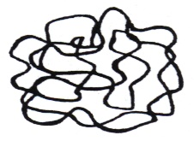
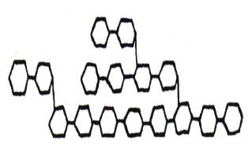
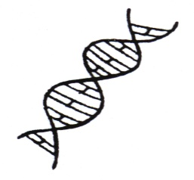
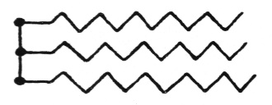
Molecules of Life
Proteins
Carbohydrates
Nucleic acids
Lipids

Slide 5
THE BUILDING BLOCKS OF ORGANISMS
Polymers are made by covalent linkage of monomers
e.g. amino acids nucleotide monosaccharide
peptide or
oligopeptide
oligonucleotide
oligosaccharide
Polypeptide (protein)
Nucleic acid
Polysaccharide
(carbohydrate)

Slide 6
CONDENSATION AND HYDROLYSIS REACTIONS
Condensation
monomer
+
monomer
H₂O
monomer
monomer
etc.
monomer
monomer
monomer
monomer
monomer

Slide 7
Hydrolysis
monomer
monomer
H₂O
monomer
monomer

Slide 8
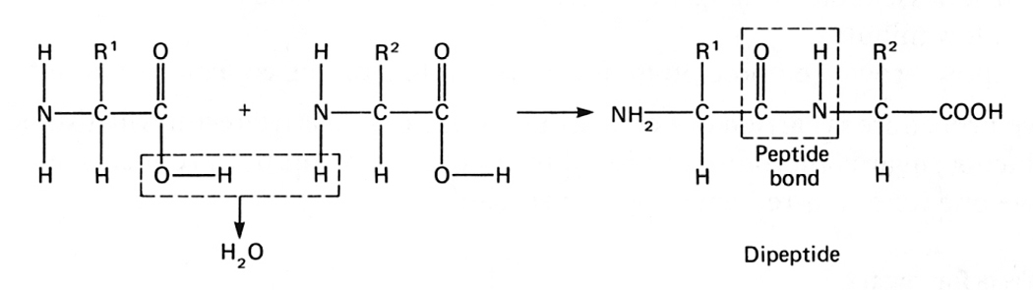
Amino acid 1
Amino acid 2

Slide 9
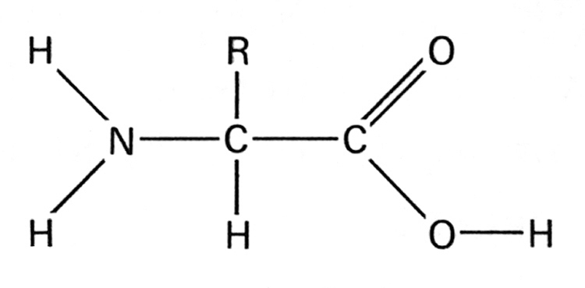
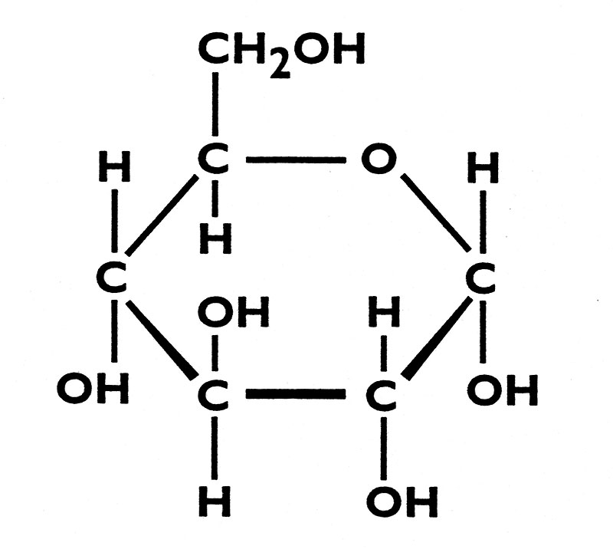
IDENTIFYING MONOMERS OF MACROMOLECULES
Carboxyl group
Amino group

Slide 10
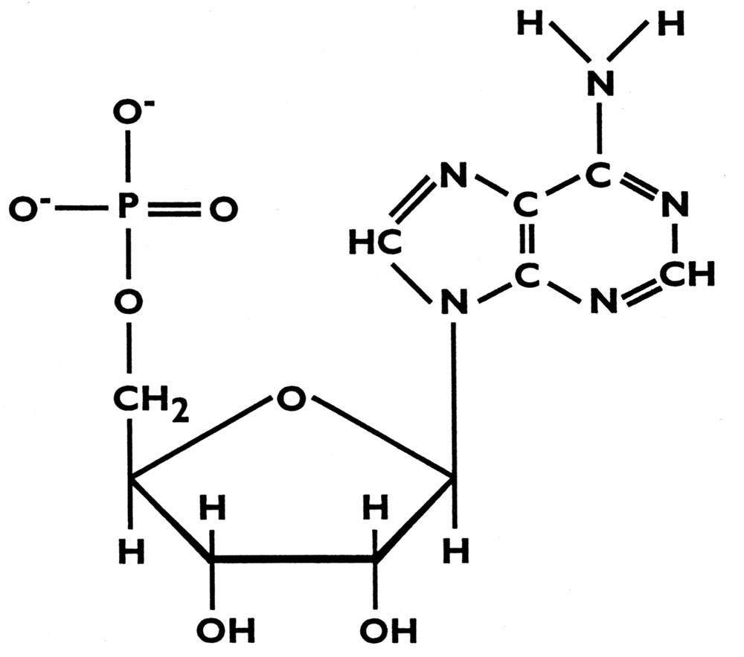
IDENTIFYING MONOMERS OF MACROMOLECULES
nitrogen base
phosphate
ribose

Slide 11
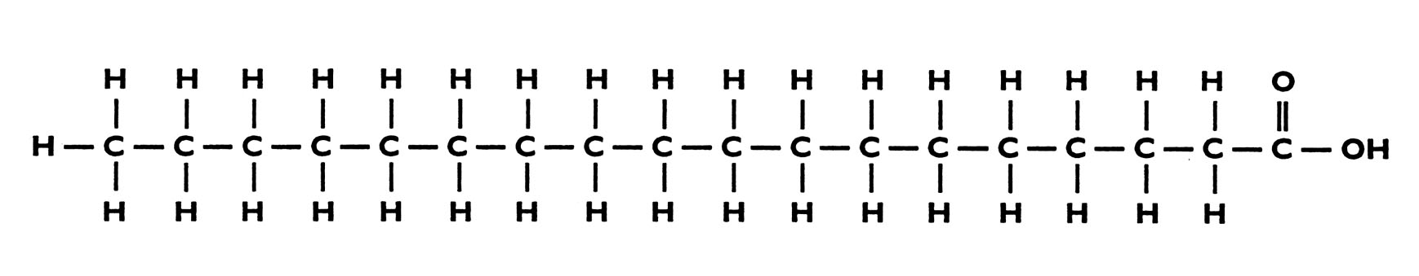
IDENTIFYING MONOMERS OF MACROMOLECULES
*
hydrocarbon chain
carboxyl
group
*LIPIDS - often regarded as macromolecules
but are not formed by polymerization.

Slide 12
THE IMPORTANCE OF CARBON
Carbon forms covalent bonds with as many as four other atoms.
Carbon in organic compounds can bond to a variety of other atoms.

Slide 13
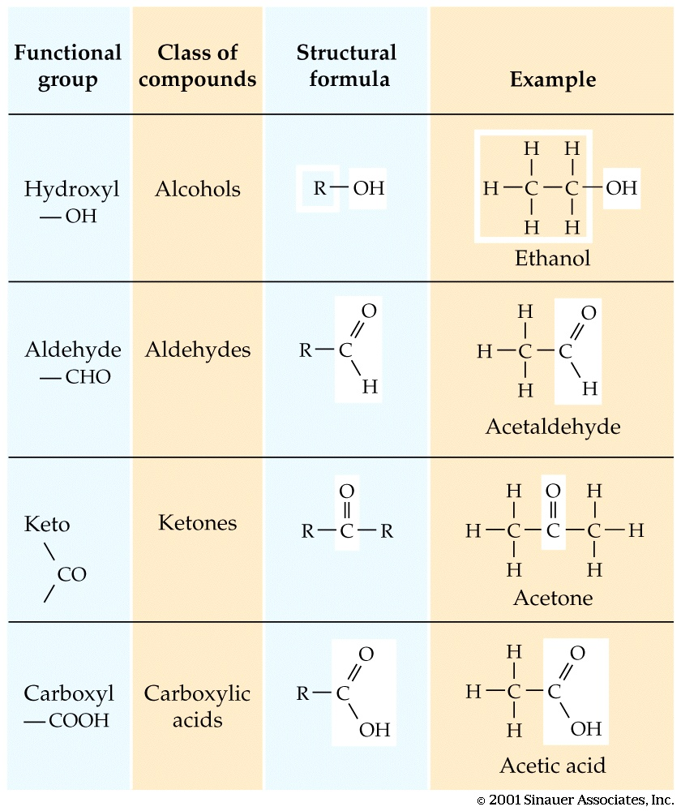
FUNCTIONAL GROUPS
Purves et al Fig. 2.20

Slide 14
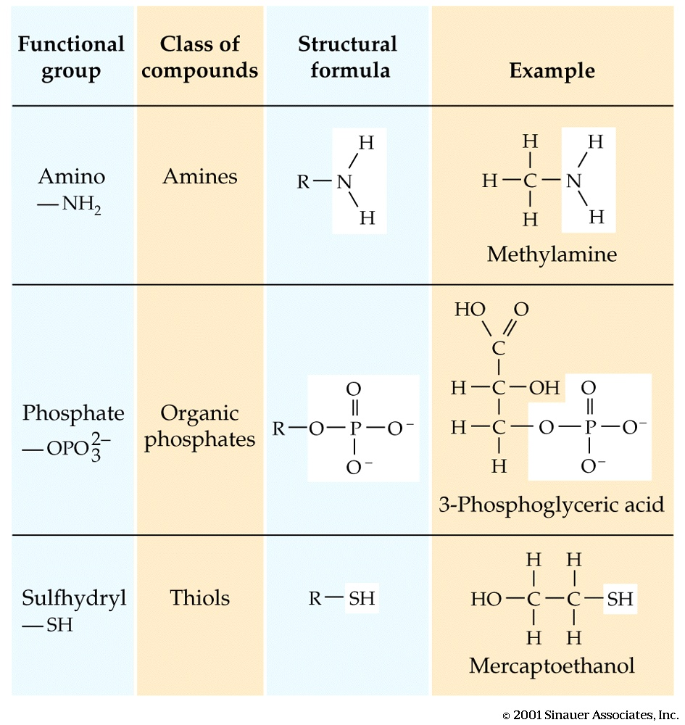
.
Purves et al Fig. 2.20

Slide 15
Carbohydrates
By
Dr. C. I. Nyamwange
http://www.themedicalbiochemistrypage.org

Slide 16
Functions of carbohydrates
Some of the functions of carbohydrates include:
Major sources of energy, especially the 6-Carbon sugars (hexoses).
Are important substrates for building other needed molecules (e.g. amino acids)
5-Carbon sugars (ribose, deoxyribose) are integral parts of RNA and DNA backbone chains.
They act as molecular "tags". Carbohydrates found on membrane proteins facing outside of the cell are used for recognition of specific cells and molecules. Proteins with sugar tags are called glycoprotein.
They are structural molecules
Sparing the use of proteins for energy.
Breakdown of fatty acids and preventing ketosis

Slide 17
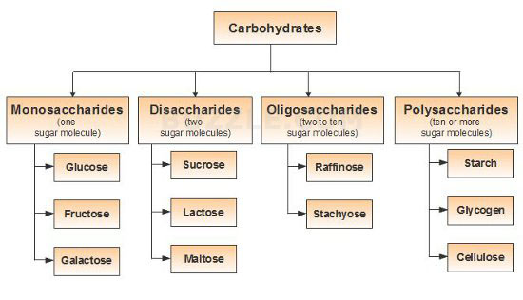
Classification of carbohydrates

Slide 18
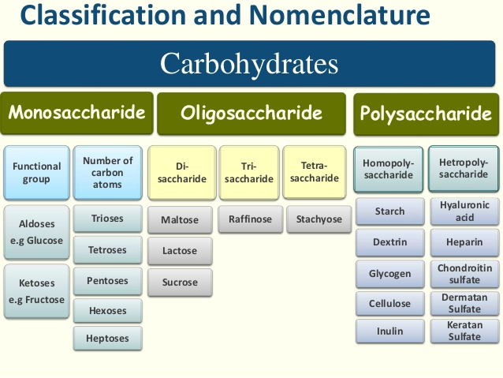

Slide 19
Carbohydrates (glycans) have the following basic composition:
Monosaccharides - simple sugars with multiple OH groups. Based on number of carbons (3, 4, 5, 6), a monosaccharide is a triose, tetrose, pentose or hexose.
Disaccharides - 2 monosaccharides covalently linked through a glycosidic bond.
Oligosaccharides - a few monosaccharides (3-10) covalently linked.
Polysaccharides - polymers consisting of chains of monosaccharide or disaccharide units.

Slide 20
Monosaccharides
Monosaccharides, are either aldehydes or ketones with two or more hydroxyl groups; the six-carbon monosaccharides of glucose and fructose have five hydroxyl groups.
Aldoses (e.g., glucose) have an aldehyde group at one end.
Ketoses (e.g., fructose) have a keto group, usually at C2.

Slide 21
Classification of monosaccharides
No. of Carbons | Category Name | Relevant examples
3 | Triose | Aldose | Ketose
 |  | Glyceraldehyde, | Dihydroxyacetone
4 | Tetrose | Erythrose | Erythrulose
5 | Pentose | Ribose | Ribulose, Xylulose
6 | Hexose | Glucose, Galactose, Mannose, | Fructose, Psicose
7 | Heptose | Mannoheptose | Sedoheptulose
9 | Nonose | Neuraminic acid (sialic acid)

Slide 22
D vs L Designation
D & L designations are based on the configuration about the single asymmetric C in glyceraldehyde. The stereoisomers are mirror images of each other
An asymmetric carbon is a carbon that has four different groups or atoms attached to it and having optically activity in solution.
The lower representations are Fischer Projections.

Slide 23
Sugar Nomenclature
For sugars with more than one chiral center, D or L refers to the asymmetric C farthest from the aldehyde or keto group.
Most naturally occurring sugars are D isomers.

Slide 24
D & L sugars are mirror
images of one another.
They have the same
name, e.g., D-glucose
& L-glucose.
Other stereoisomers
have unique names,
e.g., glucose, mannose,
Galactose (Epimers:
configuration differing at
chiral centre at position 4 and 2 respectively).
The number of stereoisomers is 2^{n}, where n is the number of asymmetric centers.
The 6-C aldoses have 4 asymmetric centers. Thus there are 16 stereoisomers (8 D-sugars and 8 L-sugars).

Slide 25
Configarational Relationships Among the Isomeric D-Aldotetroses, D-Aldopentoses, and D-Aldohexoses

Slide 26
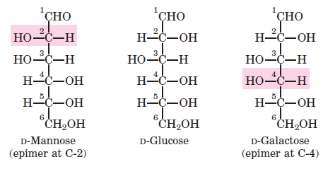
Epimers of Glucose

Slide 27
Hemiacetal & hemiketal formation
An aldehyde can react with an alcohol to form a hemiacetal.
A ketone can react with an alcohol to form a hemiketal.

Slide 28
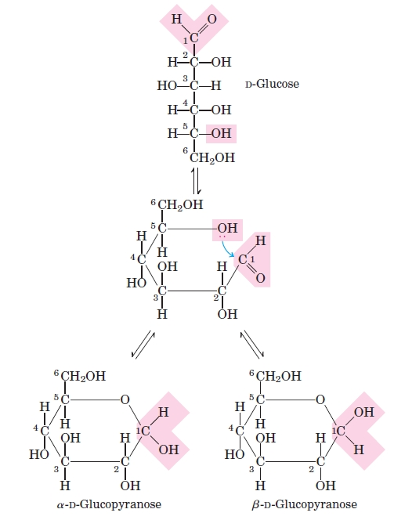
Pentoses and hexoses can cyclize as the ketone or aldehyde reacts with a distal OH.
Glucose forms an intra-molecular hemiacetal, as the C1 aldehyde & C5 OH react, to form a 6-member pyranose ring.
These representations
of the cyclic sugars are
called Haworth projections.

Slide 29
Cyclization of glucose produces a new asymmetric center at C1. The 2 stereoisomers are called anomers, α & β.
Haworth projections represent the cyclic sugars as having essentially planar rings, with the OH at the anomeric C1:
α (OH below the ring)
β (OH above the ring).

Slide 30
Fructose forms either
a 6-member pyranose ring, by reaction of the C2 keto group with the OH on C6, or
a 5-member furanose ring, by reaction of the C2 keto group with the OH on C5.

Slide 31
Sugar derivatives
sugar alcohol - lacks an aldehyde or ketone; e.g., ribitol.
sugar acid - the aldehyde at C1, or OH at C6, is oxidized to a carboxylic acid; e.g., gluconic acid, glucuronic acid.

Slide 32
Sugar derivatives cont’d
amino sugar - an amino group substitutes for a hydroxyl. An example is glucosamine.
The amino group may be acetylated, as in N-acetylglucosamine.

Slide 33
N-acetylneuraminate (N-acetylneuraminic acid, also called sialic acid) is often found as a terminal residue of oligosaccharide chains of glycoproteins.
Sialic acid imparts negative charge to glycoproteins, because its carboxyl group tends to dissociate a proton at physiological pH.

Slide 34
Characteristic Rxns of monosaccharides

Slide 35
Physical properties of Carbohydrates
Physical properties of Monosaccharides
They are colorless, crystalline compounds, readily soluble in water.
Their solutions are optically active and exhibit the phenomenon of mutarotation.
Carbohydrates spontaneously change between the α and β configuration.

Slide 36
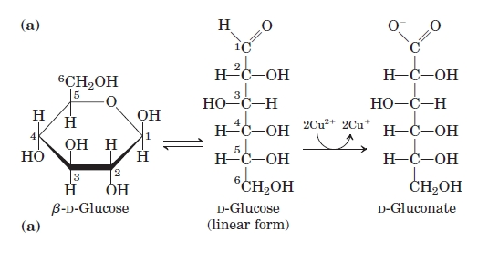
Sugars as reducing agents. Oxidation of the anomeric carbon of glucose and other sugars is the basis for Fehling’s reaction. The cuprous ion (Cu) produced under alkaline conditions forms a red cuprous oxide precipitate.
Glucose and other sugars capable of reducing ferric or cupric ion are called reducing sugars.

Slide 37
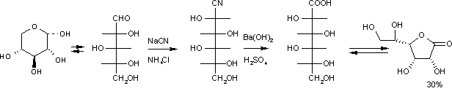
Cyanohydrin reaction
A Cyanohydrin reaction is an organic chemical reaction by an aldehyde or ketone with a cyanide anion or a nitrile to form a cyanohydrin. This nucleophilic addition is a reversible reaction but with aliphatic carbonyl compounds equilibrium is in favor of the reaction products.

Slide 38

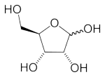
Furfural formation
When five carbon sugars are heated with strong acids, they undergo dehydration, losing three water molecules to become furfural:
C₅H₁₀O₅ → C₅H₄O₂ + 3 H₂O

Slide 39

Glycoside formation: Monosaccharides react with alcohols to form acetals called glycosides

Slide 40
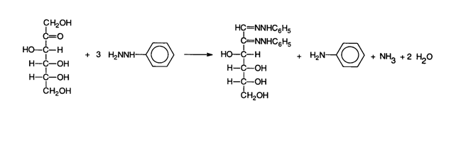
Osazone formation
Osazones formed when sugars are reacted with phenylhydrazine. The reaction involves reaction of glucose with phenylhydrazine to form glucosephenylhydrazone which reacts with two moles of phenylhydrazine, the 1st phenylhydrazine oxidizes the alpha carbon to a carbonyl group, and the 2nd phenylhydrazine removes one water molecule from formyl group of the oxidized carbon and forming the similar carbon nitrogen bond

Slide 41


Formation of saccharic acids: Saccharic acid, also called glucaric acid, is a chemical compound with the formula C₆H₁₀O₈. It is derived by oxidizing a sugar such as glucose with nitric acid resulting in both C1 and C6 being oxidized to carboxylic groups
Glucose glucaric acid

Slide 42
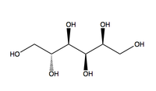
Formation of sorbitol
Sorbitol, also known as glucitol, is a sugar alcohol that the body metabolises slowly. It is obtained by reduction of glucose changing the aldehyde group to an additional hydroxyl group hence the name sugar alcohol.
Glucose Sorbitol

Slide 43
Glycosidic Bonds
The anomeric hydroxyl and a hydroxyl of another sugar or some other compound can join together, splitting out water to form a glycosidic bond:
R-OH + HO-R' → R-O-R' + H₂O
E.g., methanol reacts with the anomeric OH on glucose to form methyl glucoside (methyl-glucopyranose).

Slide 44
Disaccharides:
Disaccharides (such as maltose, lactose, and sucrose) consist of two monosaccharides joined covalently by an O-glycosidic bond, which is formed when a hydroxyl group of one sugar reacts with the anomeric carbon of the other
Disaccharides can be hydrolyzed to yield their free
monosaccharide components by boiling with dilute acid.

Slide 45
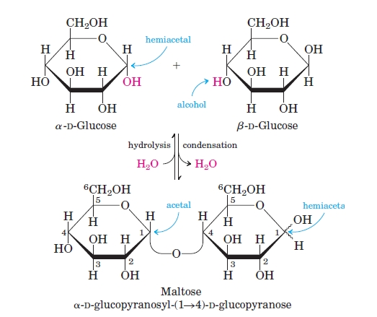
Maltose, a cleavage product of starch (e.g., amylose), is a disaccharide with an α(1→4) glycosidic link between C1 - C4 OH of 2 glucose molecules.
It is the α anomer (C1 O points down).

Slide 46
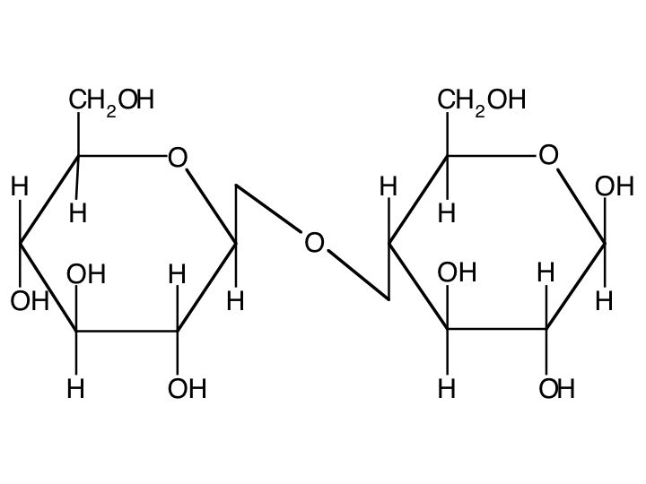
Cellobiose, a product of cellulose breakdown, is the otherwise equivalent β anomer (O on C1 points up).
The β(1→4) glycosidic linkage is represented as a zig-zag, but one glucose is actually flipped over relative to the other.

Slide 47

Sucrose: A common table sugar, has a glycosidic bond linking the anomeric hydroxyls of glucose & fructose.
Because the configuration at the anomeric C of glucose is α (O points down from ring), the linkage is α(1→2).
The full name of sucrose is α-D-glucopyranosyl-(1→2)-β-D-fructopyranose.)
glucose fructose

Slide 48
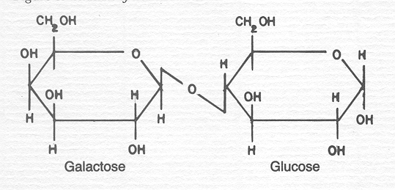
Lactose, milk sugar, is composed of galactose & glucose, with β(1→4) linkage from the anomeric OH of galactose. Its full name is β-D-galactopyranosyl-(1→ 4)-α-D-glucopyranose

Slide 49
Polysaccharides:
Polysaccharides are polymers of monosacchairdes of medium to high molecular weight.
Polysaccharides, also called glycans, differ from each other in the identity of their recurring monosaccharide units, in the length of their chains, in the types of bonds linking the units, and in the degree of branching.
Homopolysaccharides contain only a single type of monomer eg starch, glycogen, cellulose;
Some homopolysaccharides serve as storage forms of monosaccharides that are used as fuels e.g starch and glycogen. Other homopolysaccharides i.e cellulose and chitin serve as structural elements in plant cell walls and animal exoskeletons

Slide 50
Starch
Plants store glucose as amylose or amylopectin, glucose polymers collectively called starch.
Glucose storage in polymeric form minimizes osmotic effects.
Amylose is a glucose polymer with α(1→4) linkages. The end of the polysaccharide with an anomeric C1 not involved in a glycosidic bond is called the reducing end.

Slide 51
Amylopectin is a glucose polymer with mainly α(1→4) linkages, but it also has branches formed by α(1→6) linkages. Branches are generally longer than shown above.
The branches produce a compact structure & provide multiple chain ends at which enzymatic cleavage can occur.

Slide 52
Glycogen: The glucose storage polymer in animals, is similar in
structure to amylopectin but glycogen has more α(1→6)branches.
Branching occurs on average at every 8 to 12 residues
The highly branched structure permits rapid glucose release from glycogen stores, e.g., in muscle during exercise. The ability to rapidly mobilize glucose is more essential to animals than to plants.

Slide 53
Cellulose: A major constituent of plant cell walls, consists of long linear chains of glucose with β(1→4) linkages.
Every other glucose is flipped over, due to β linkages.
This promotes intra-chain and inter-chain H-bonds.
van der Waals interactions, that cause cellulose chains to be straight & rigid, and pack with a crystalline arrangement in thick bundles - microfibrils.
.

Slide 54
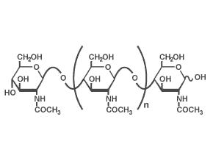
Chitin (C₈H₁₃O₅N)n is a long-chain polymer of a N-acetylglucosamine, found in many places throughout the natural world. It is the main component of the cell walls of fungi and the exoskeletons of arthropods. Chitin's properties as a flexible and strong material make it favorable as surgical thread. Its biodegradibility means it wears away with time as the wound heals

Slide 55
Other polysaccharides
Dextrins are intermediates in the hydrolysis of starch and glycogen. They are products of α-mylase activity on amylopectin and glycogen it cannot attack the α-1,6 glycoside linkages, thus leaving behind the glucose polymer skeleton called dextrin.
Hemicellulose:These are polysaccharide components of plant cell walls other than cellulose. They consist of long chains of a variety of pentoses, hexoses, and their corresponding uronic acids. Hemicelluloses may be found in fruits, plant stems, and grain hulls.

Slide 56
Mucopolysaccharides are complex polysaccharides charactirised by their contents of amino sugars and uronic acid. Examples are hyaluronic acid, chondroitin sulphate and heparin.
Pectin is a polysaccharide that acts as a cementing material in the cell walls of all plant tissues. The white portion of the rind of lemons and oranges contains approximately 30% pectin. Pectin is the methylated ester of polygalacturonic acid, which consists of chains of 300 to 1000 galacturonic acid units joined with α-1,4 linkages.

Slide 58
Nucleotides

Slide 59
Nitrogen Bases
There are two kinds of nitrogen-containing bases - purines and pyrimidines.
Purines consist of a six-membered and a five-membered nitrogen-containing ring, fused together.
Pyridmidines have only a six-membered nitrogen-containing ring.
There are 4 purines and 4 pyrimidines that are of concern to us.
Adenine and guanine are found in both DNA and RNA. Hypoxanthine and xanthine are not incorporated into the nucleic acids as they are being synthesized but are important intermediates in the synthesis and degradation of the purine nucleotides.

Slide 60
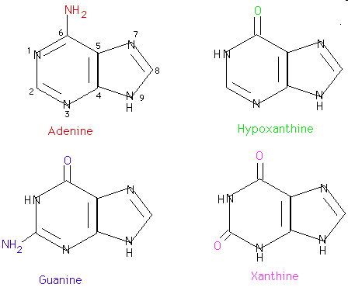
Purines

Slide 61
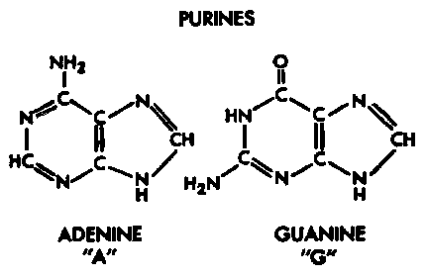
Purines
Adenine = 6-amino purine
Guanine = 2-amino-6-oxy purine

Slide 62
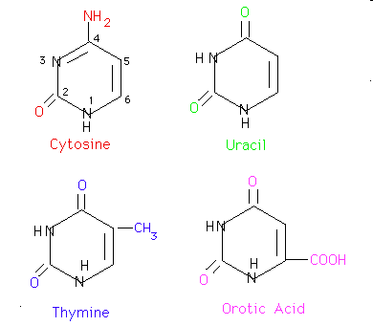
Pyrimidines

Slide 63
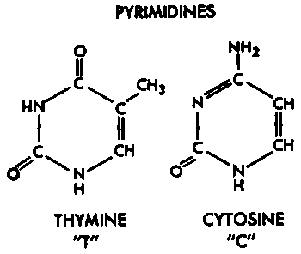
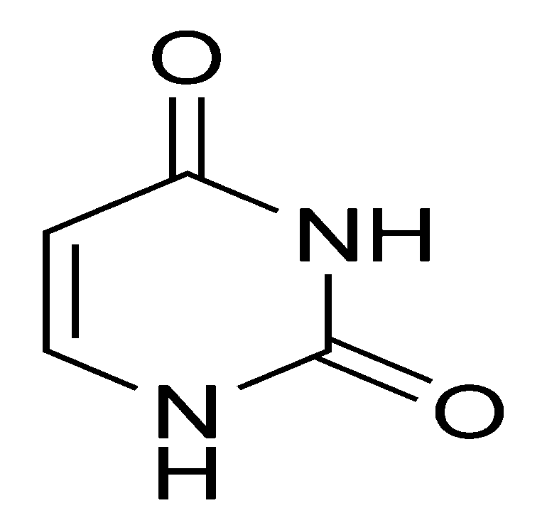
Pyrimidines
Uracil = 2,4-dioxy pyrimidine
Thymine = 2,4-dioxy-5-methyl pyrimidine
Cytosine = 2-oxy-4-amino pyrimidine
URACIL

Slide 64
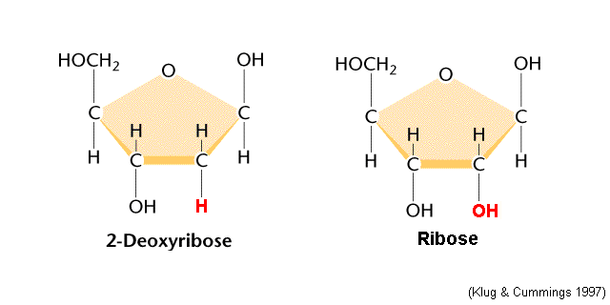
Pentose sugars

Slide 65
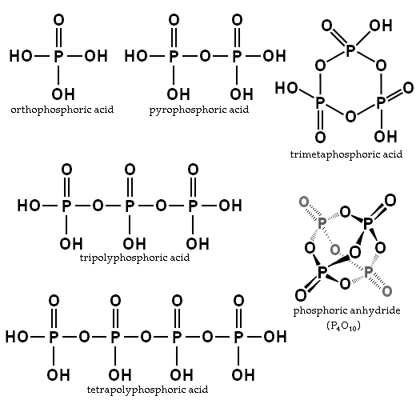
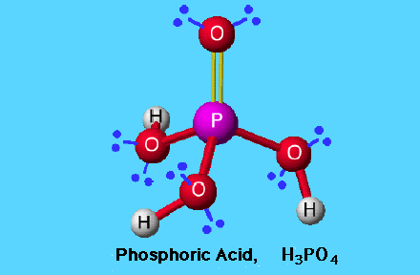
Phosphoric Acid

Slide 66
Nucleosides
If a sugar, either ribose or 2-deoxyribose, is added to a nitrogen base, the resulting compound is called a nucleoside. Carbon 1 of the sugar is attached to nitrogen 9 of a purine base or to nitrogen 1 of a pyrimidine base.
The names of purine nucleosides end in -osine and the names of pyrimidine nucleosides end in -idine. The convention is to number the ring atoms of the base normally and to use l', etc. to distinguish the ring atoms of the sugar.
Unless otherwise specified, the sugar is assumed to be ribose. To indicate that the sugar is 2'-deoxyribose, a d- is placed before the name.

Slide 67
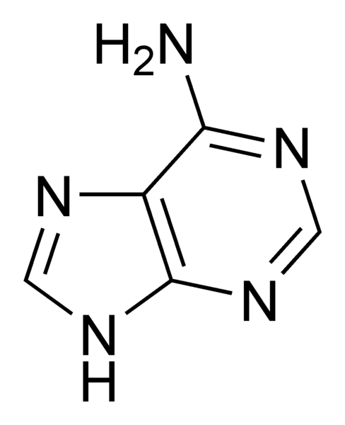
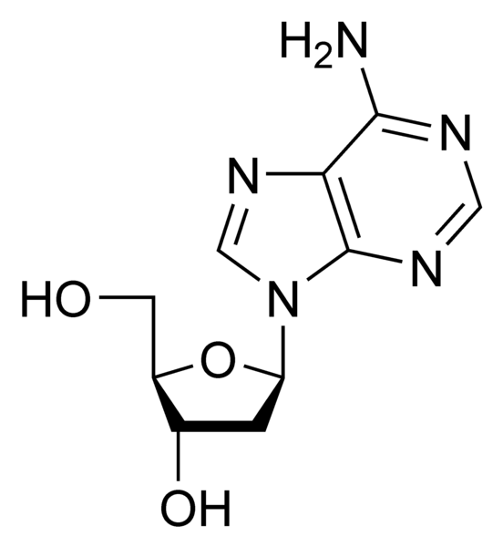
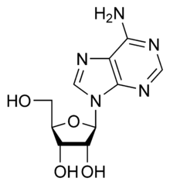
Nucleosides
Adenine
Adenosine
Deoxyadenosine

Slide 68
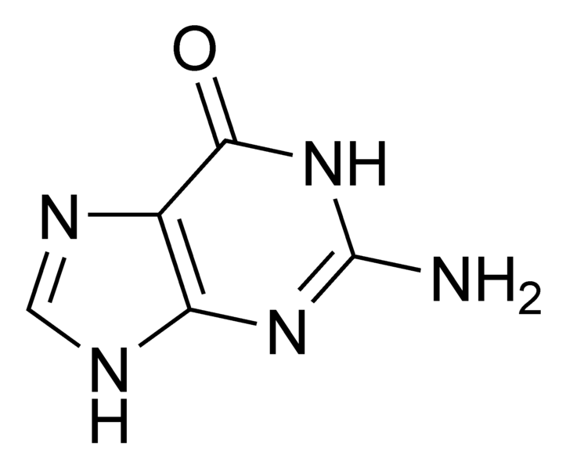
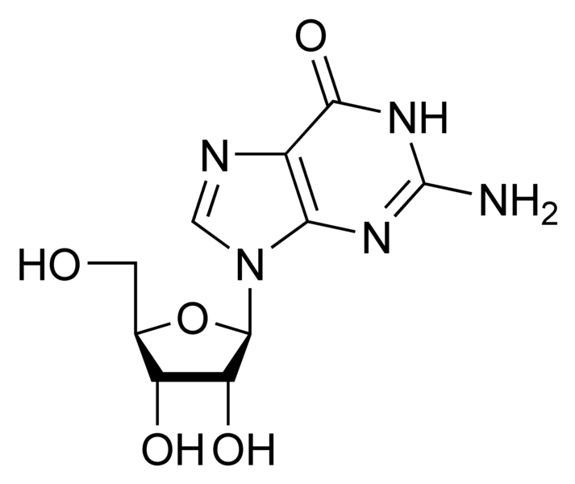
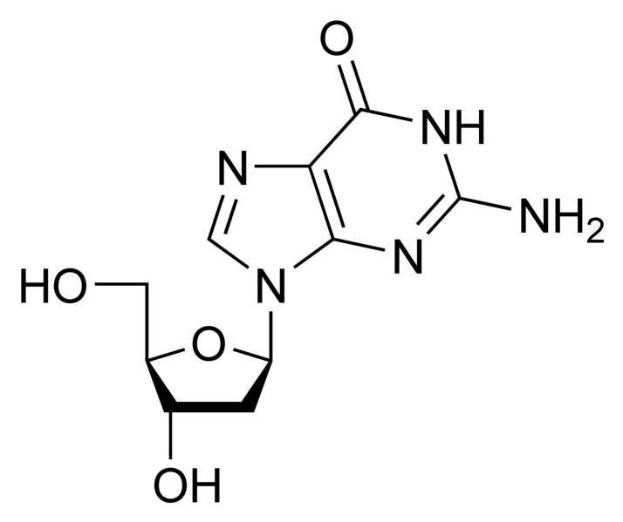
Guanine
Guanosine
Deoxyguanosine

Slide 69
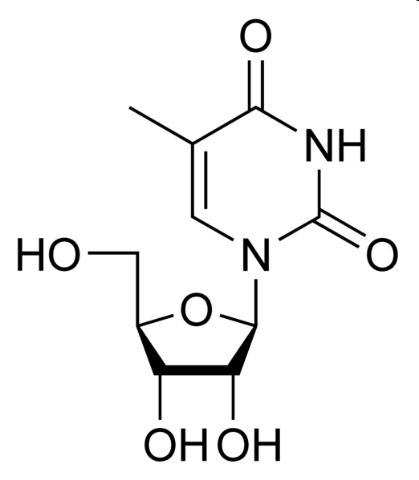
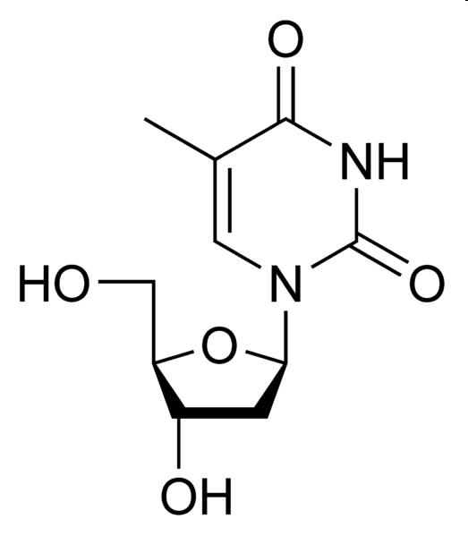
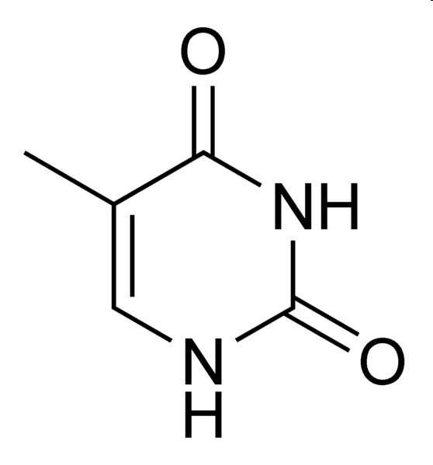
Thymine
Thymidine
Deoxythymidine

Slide 70

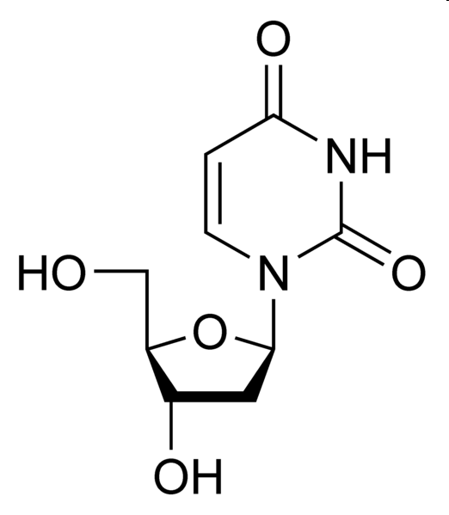
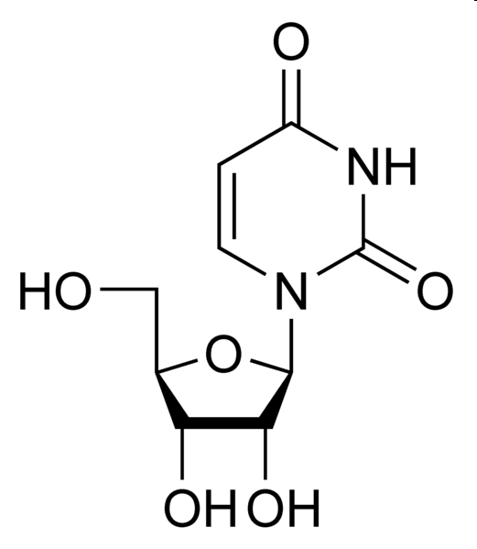
Uridine
Deoxyuridine
Uracil

Slide 71
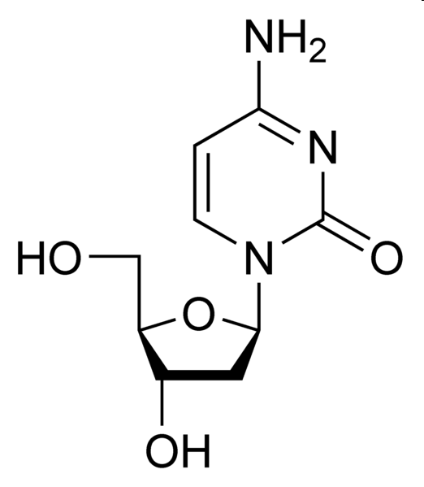
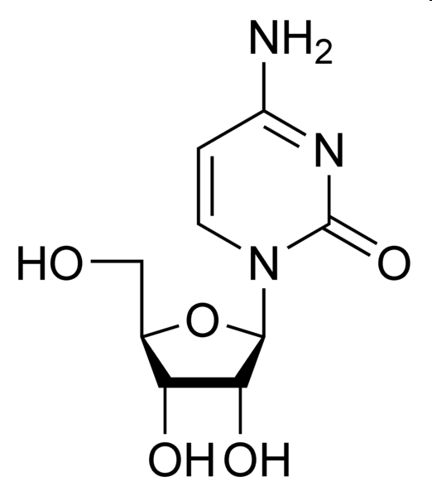
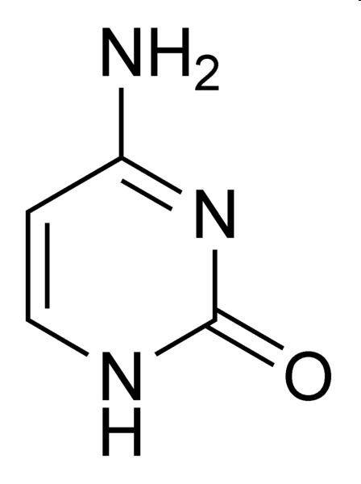
Cytosine
Cytidine
Deoxycytidine

Slide 72
Nucleotides
A nucleotide is a chemical compound that consists of 3 portions: a nitrogenous base, a sugar, and one or more phosphate groups
In the most common nucleotides the base is a derivative of purine or pyrimidine, and the sugar is the pentose deoxyribose or ribose.
Nucleotides are the structural units of RNA, DNA, and several cofactors - CoA, flavin adenine dinucleotide, flavin mononucleotide, adenosine triphosphate and nicotinamide adenine dinucleotide phosphate. In the cell they have important roles in metabolism and signaling.

Slide 73
Components of Nucleotides
Nitrogenous bases: There are two kinds of nitrogen-containing bases - purines and pyrimidines.
Purines consist of a six-membered and a five-membered nitrogen-containing ring, fused together.
Pyridmidines have only a six-membered nitrogen-containing ring.
There are 4 purines and 4 pyrimidines that are of concern to us.

Slide 74
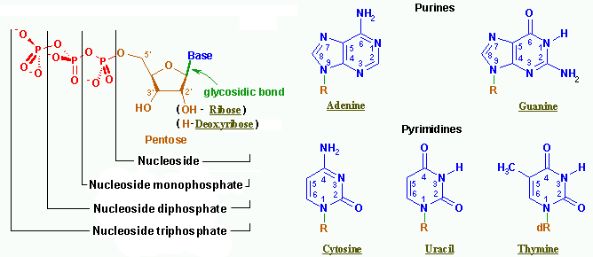
Nucleotides

Slide 75
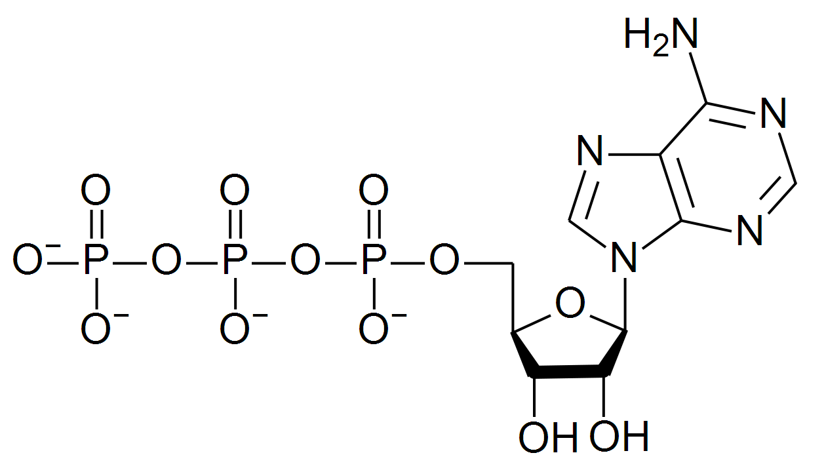
Adenosine Triphosphate

Slide 76
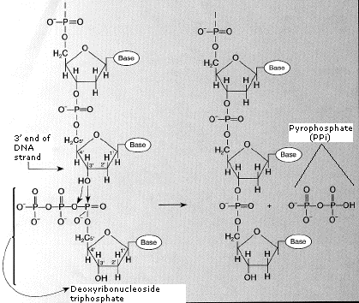

Slide 77
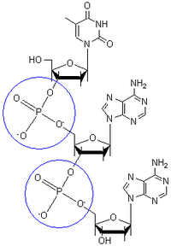
Phosphodiester bond

